Slide 1
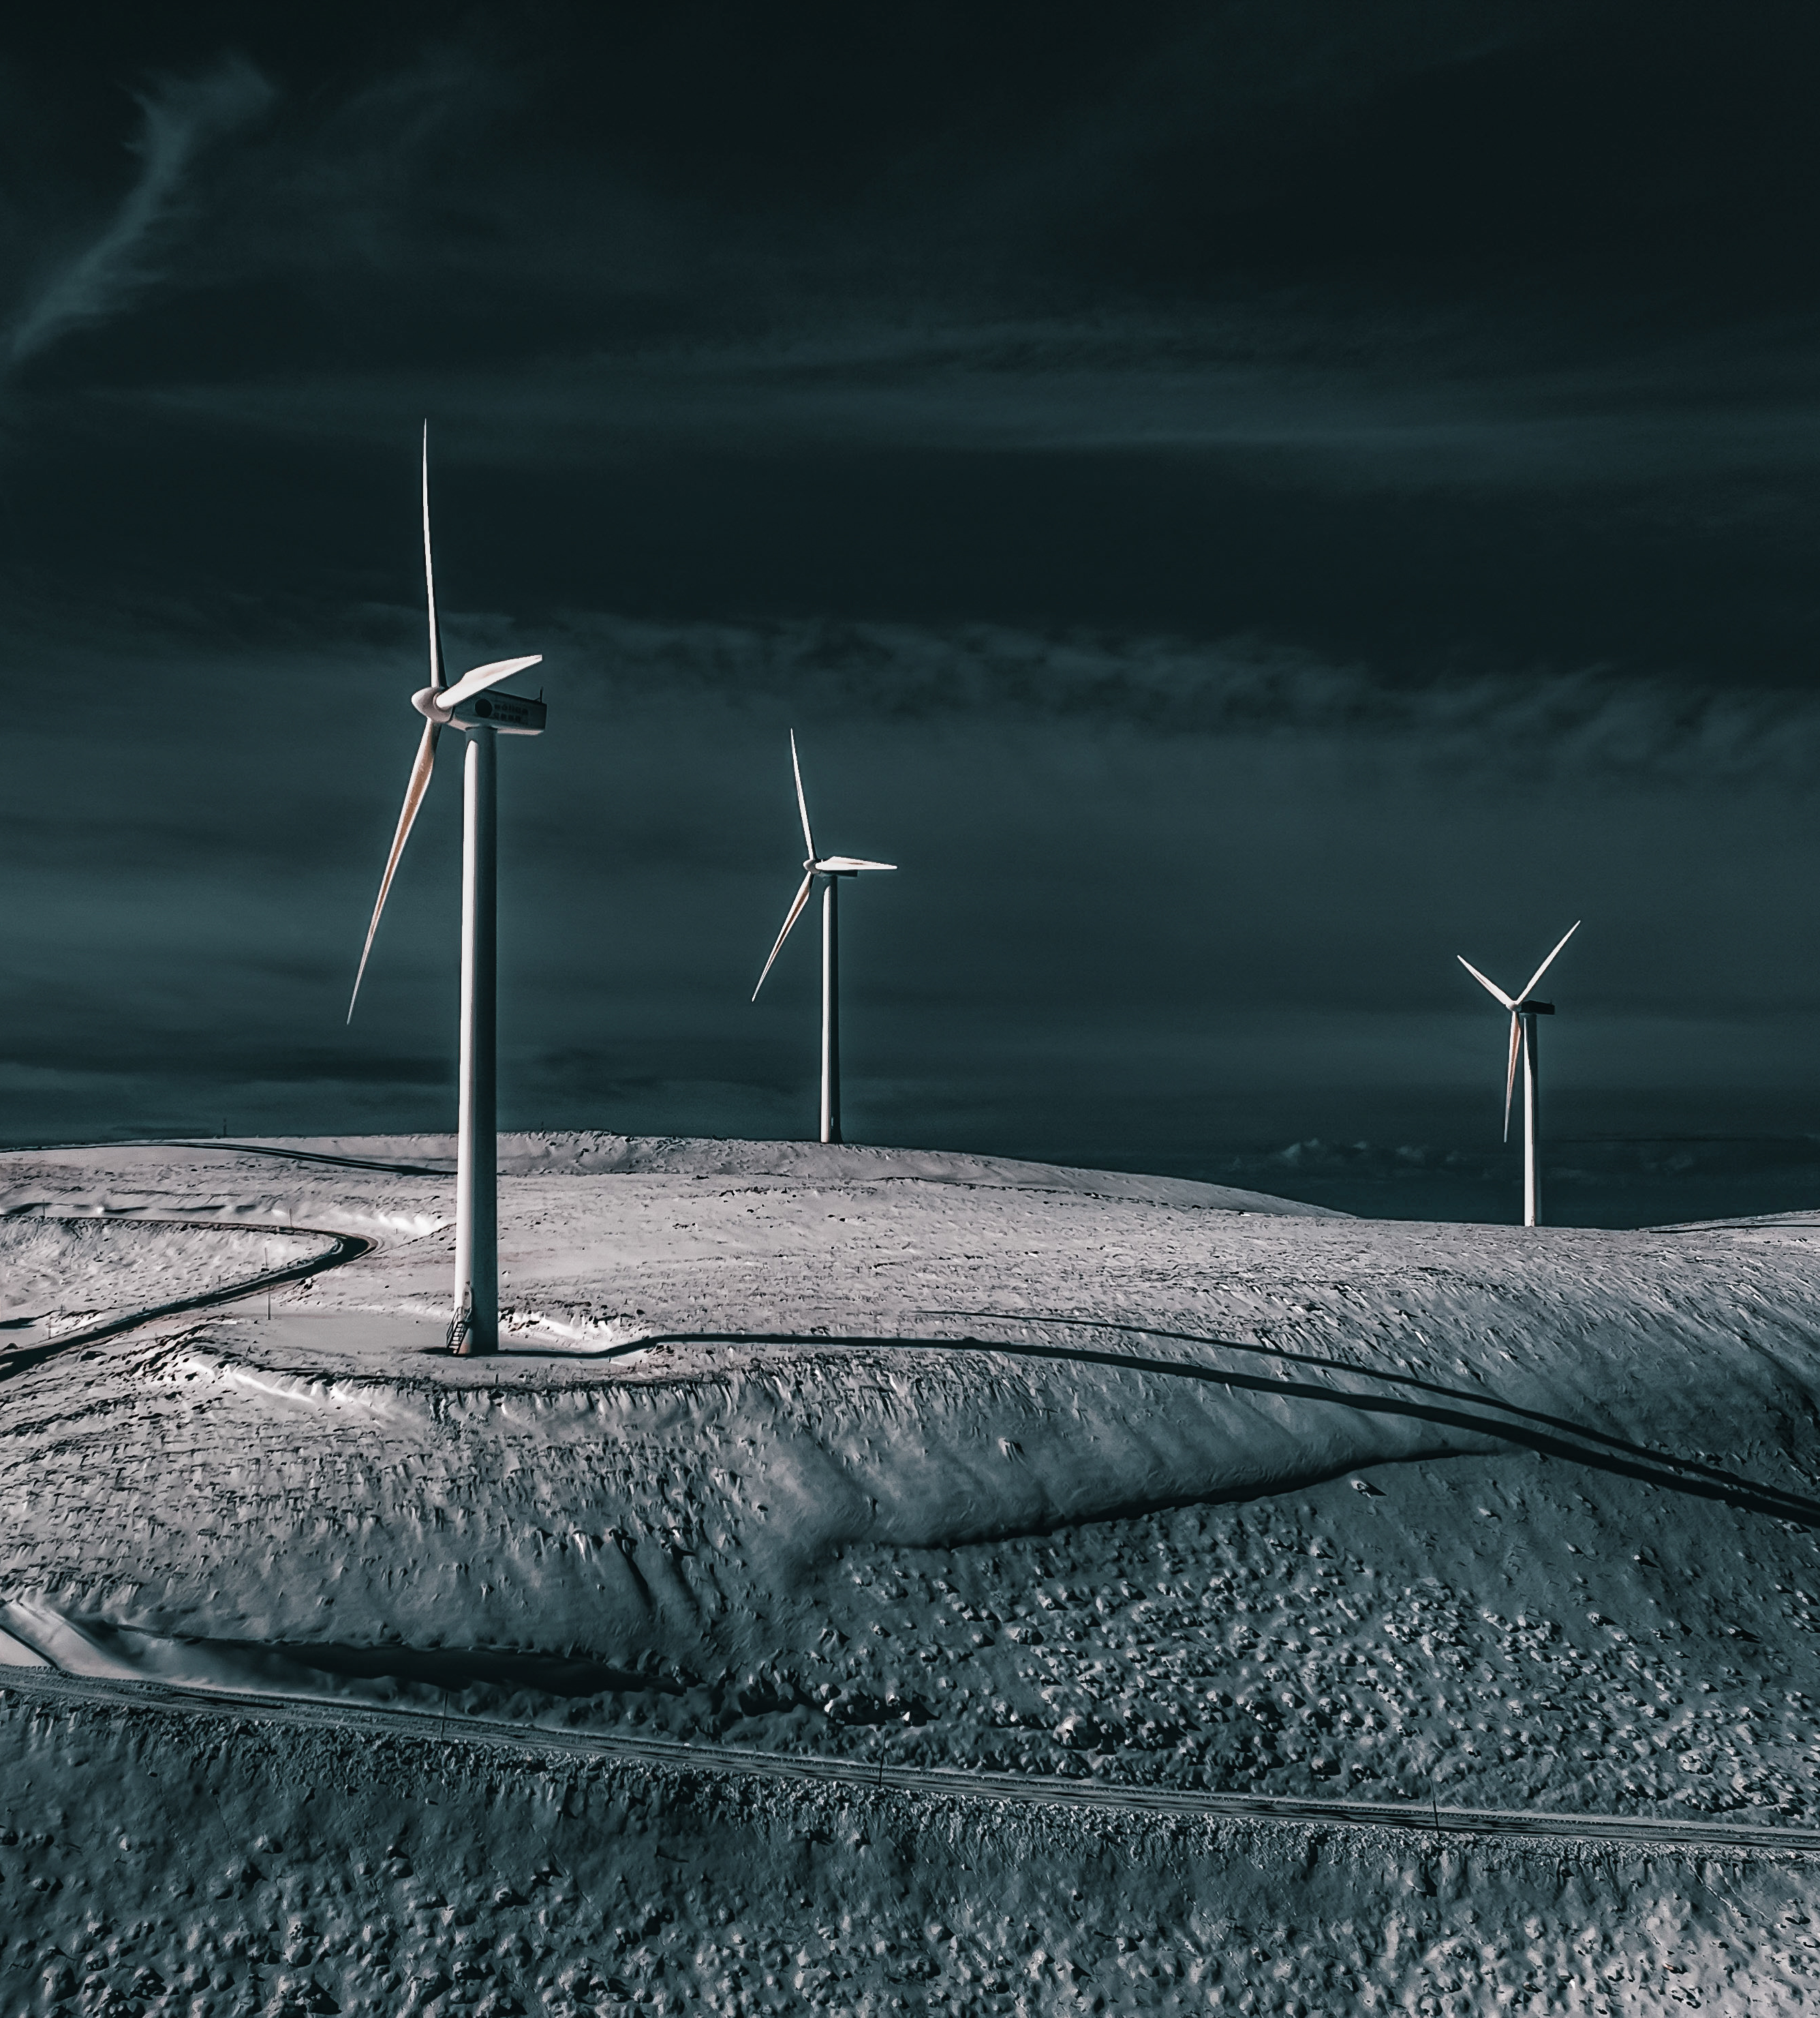

Challenges for
RENEWABLES
in the new era
Panagiotis Papastamatiou
Hellenic Wind Energy Association ELETAEN
4rth Energy Law Forum – November 2024

Slide 2
Permitting of renewables within the Emergency Regulation and RED III
4rth Energy Law Forum – November 2024

Slide 3

Emergency Regulation and RED III : Some important dates
14 July 2021 Publication of the Fit-for-55 package, including the revision of the RED
18 May 2022 Publication of the REPowerEU package, including amendments to the RED
30 December 2022 Emergency Regulation on Permitting (Reg EU 2022/2577) for 18m i.e. until 30 June 2024
20 November 2023 Entry into force of RED III (Dir EU 2018/2001 as amended)
18 December 2023 Amending and Prolongation of some clauses of the Emergency Regulation on Permitting (incl. Art. 3(2) and Art. 3a) until 30 June 2025
1 July 2024 Transposition deadline for permitting provisions i.e. Art. 16 incl. clause for Overriding Public Interest
21 May 2025 Transposition deadline for the rest of the directive. Deadline to design the 2030 RES areas
1 July 2025 End of the application of the Emergency Regulation on Permitting
21 November 2025 All permit-granting procedures shall be carried out in electronic form
21 February 2026 Deadline to design the Renewable Acceleration Areas (RAAs)

Slide 4
Permitting timelines in & outside RAAs (RED III, Art. 16a-16c)
 | In RAAs | Outside RAAs
New projects | 1 year + 6m Offshore 2 years + 6m | 2 years + 6m Offshore 3 years +6m
Repowering projects | 6 months + 3m Offshore 1 year +6m | 1 year + 3m Offshore 2 years + 3m
Repowering projects <15% increased capacity | 3 months

Slide 5
Positive silence in RAAs | RED III, Art. 16c(6)
6. In the permit-granting procedure referred to in paragraphs 1 and 2, Member States shall ensure that the lack of reply by the relevant competent authorities within the established deadline results in the specific intermediary administrative steps to be considered as approved, except where the specific renewable energy project is subject to an environmental impact assessment pursuant to paragraph 5 or where the principle of administrative tacit approval does not exist in the national legal system of the Member State concerned. This paragraph shall not apply to final decisions on the outcome of the permit-granting procedure, which shall be explicit. All decisions shall be made publicly available.

Slide 6
Single procedure for EIA & population approach outside RAAs | RED III, Art. 16b(2)
SOS
2. Where an environmental assessment is required pursuant to Directive 2011/92/EU or 92/43/EEC, it shall be carried out in a single procedure that combines all relevant assessments for a given renewable energy project.
(…)
Where a renewable energy project has adopted necessary mitigation measures, any killing or disturbance of the species protected under Article 12(1) of Directive 92/43/EEC and Article 5 of Directive 2009/147/EC shall not be considered to be deliberate.

Slide 7
RAAs in the Greek legislation | L.3468/2006, Art. 7A as added by L. 5037/2023, Art. 164
Άρθρο 7A - Περιοχές Πρώτης Επιλογής για Ανανεώσιμων Πηγών Ενέργειας
1. Οι Περιοχές Πρώτης Επιλογής Α.Π.Ε. είναι υποσύνολο των περιοχών που απαιτούνται για την επίτευξη των ποσοτικών στόχων του Εθνικού Σχεδίου για την Ενέργεια και το Κλίμα (ΕΣΕΚ, Β’ 4893/2019) για το 2030. Οι περιοχές αυτές βρίσκονται εκτός προστατευόμενων περιοχών του Δικτύου «Natura 2000» και οριοθετούνται όπου η ανάπτυξη συγκεκριμένης κατηγορίας ή τεχνολογίας τύπων έργων Α.Π.Ε. δεν αναμένεται να έχει σημαντικές περιβαλλοντικές επιπτώσεις.
2. Η έγκριση Περιοχής Πρώτης Επιλογής για Α.Π.Ε. γίνεται με προεδρικό διάταγμα, που εκδίδεται μετά από πρόταση του Υπουργού Περιβάλλοντος και Ενέργειας και γνώμη του Κεντρικού Συμβουλίου Χωροταξικών Θεμάτων και Αμφισβητήσεων, κατόπιν Στρατηγικής Μελέτης Περιβαλλοντικών Επιπτώσεων. Με το προεδρικό διάταγμα: (α) ορίζονται οι όροι ανάπτυξης των έργων Α.Π.Ε., η κατανομή των περιοχών εγκατάστασης και η μέγιστη ισχύς των έργων σε κάθε περιοχή εγκατάστασης, (β) εγκρίνονται οι κατευθύνσεις, όροι και τα μέτρα για την προστασία του περιβάλλοντος.
3. Τα έργα Α.Π.Ε. που αναπτύσσονται εντός Περιοχών Πρώτης Επιλογής για ΑΠΕ, σύμφωνα με τους όρους και τα μέτρα για την προστασία του περιβάλλοντος της παρ. 2, εξαιρούνται από τη διαδικασία περιβαλλοντικής αδειοδότησης και την Ειδική Οικολογική Αξιολόγηση του ν. 4014/2011 (Α’ 209).»

Slide 8
The first RAA in the Greek legislation | L. 4964/2022, Art. 174, par. 1 as amended
Με το ν. 5037/2023, άρθρο 164, καθορίσθηκε:
«2. Η παρ. 1 του άρθρου 174 του ν. 4964/2022 (Α’ 150), περί πιλοτικής εφαρμογής των Υπεράκτιων Αιολικών Πάρκων, αντικαθίσταται ως εξής:
«1. Η θαλάσσια περιοχή που εκτείνεται νοτίως της ακτογραμμής της Περιφερειακής Ενότητας Έβρου και βορείως-βορειοανατολικώς της Σαμοθράκης, ορίζεται ως περιοχή ανάπτυξης πιλοτικών Έργων ΥΑΠ, για Έργα ΥΑΠ μέχρι συνολικής ισχύος εξακοσίων (600) MW. Με τη διαδικασία του άρθρου 7α του ν. 3468/2006 (Α’ 129), τμήμα της περιοχής του πρώτου εδαφίου οριοθετείται ως Περιοχή Οργανωμένης Ανάπτυξης ΥΑΠ, ενώ με την ίδια διαδικασία, τμήμα της περιοχής του πρώτου εδαφίου οριοθετείται ως Περιοχή Πρώτης Επιλογής Α.Π.Ε..»

Slide 9
The Overriding Public Interest
4rth Energy Law Forum – November 2024

Slide 10
Article 6(4) of Council Directive 92/43/EEC
4. If, in spite of a negative assessment of the implications for the site and in the absence of alternative solutions, a plan or project must nevertheless be carried out for imperative reasons of overriding public interest, including those of a social or economic nature, the Member State shall take all compensatory measures necessary to ensure that the overall coherence of Natura 2000 is protected. It shall inform the Commission of the compensatory measures adopted.
Where the site concerned hosts a priority natural habitat type and / or a priority species, the only considerations which may be raised are those relating to human health or public safety, to beneficial consequences of primary importance for the environment or, further to an opinion from the Commission, to other imperative reasons of overriding public interest.

Slide 11
Overriding Public Interest in the Emergency Regulation of Dec 2022 | Reg EU 2022/2577, Art. 3
1. The planning, construction and operation of plants and installations for the production of energy from renewable sources, and their connection to the grid, the related grid itself and storage assets shall be presumed as being in the overriding public interest and serving public health and safety when balancing legal interests in the individual case, for the purposes of Article 6(4) and Article 16(1)(c) of Council Directive 92/43/EEC ( 5 ), Article 4(7) of Directive 2000/60/EC of the European Parliament and of the Council ( 6 ) and Article 9(1)(a) of Directive 2009/147/EC of the European Parliament and of the Council ( 7 ). Member States may restrict the application of those provisions to certain parts of their territory as well as to certain types of technologies or to projects with certain technical characteristics in accordance with the priorities set in their integrated national energy and climate plans.
2. Member States shall ensure, at least for projects which are recognised as being of overriding public interest, that in the planning and permit-granting process, the construction and operation of plants and installations for the production of energy from renewable sources and the related grid infrastructure development are given priority when balancing legal interests in the individual case. Concerning species protection, the preceding sentence shall only apply if and to the extent that appropriate species conservation measures contributing to the maintenance or restoration of the populations of the species at a favorable conservation status are undertaken and sufficient financial resources as well as areas are made available for that purpose

Slide 12
Overriding Public Interest in the amended/prolonged Emergency Regulation | Art. 3
1. [Not prolonged since the deadline for the transposition to national laws of the same Art. 16f of REDIII was 1 July 2024, see Art. 5(1) of Dir EU 2023/2413 of 18 Oct 2023]
2. Member States shall ensure, at least for projects which are recognised as being of overriding public interest, that in the planning and permit-granting process, the construction and operation of plants and installations for the production of energy from renewable sources and the related grid infrastructure development are given priority when balancing legal interests in the individual case. Concerning species protection, the preceding sentence first subparagraph shall only apply if and to the extent that appropriate species conservation measures contributing to the maintenance or restoration of the populations of the species at a favourable conservation status are undertaken and sufficient financial resources as well as areas are made available for that purpose

Slide 13
Overriding Public Interest in the amended/prolonged Emergency Regulation | Art. 3a
Article 3a
Absence of alternative or satisfactory solutions
1. When assessing whether there are no satisfactory alternative solutions to a project for a plant or installation for the production of energy from renewable sources and its connection to the grid for the purposes of Articles 6(4) and 16(1) of Directive 92/43/EEC, Article 4(7) of Directive 2000/60/EC and Article 9(1) of Directive 2009/147/EC, this condition may be considered as being fulfilled if there are no satisfactory alternative solutions capable of achieving the same objective of the project in question, notably in terms of development of the same renewable energy capacity through the same energy technology within the same or similar timeframe and without resulting in significantly higher costs.
2. When assessing whether there are no satisfactory alternative solutions to a grid infrastructure project which is necessary to integrate renewables into the electricity system, for the purposes of Articles 6(4) and 16(1) of Directive 92/43/EEC, Article 4(7) of Directive 2000/60/EC and Article 9(1) of Directive 2009/147/EC, this condition may be considered fulfilled if there are no satisfactory alternative solutions capable of achieving the same objective of the project in question within the same or similar timeframe and without resulting in significantly higher costs.
De facto this leaves project developers mostly with only the 3rd condition – implement compensatory measures – to fulfil.

Slide 14
Overriding Public Interest in the amended/prolonged Emergency Regulation | Art. 3a (cont.)
Article 3a
Absence of alternative or satisfactory solutions
3. When implementing compensatory measures for a project for a plant or installation for the production of energy from renewable sources, and the related grid infrastructure which is necessary to integrate renewables into the electricity system, for the purpose of Article 6(4) of Directive 92/43/EEC, Member States may allow for such compensatory measures to be carried out in parallel with the implementation of the project, unless there is clear evidence that a specific project would irreversibly affect the ecological processes essential for maintaining the structure and functions of the site and would compromise the overall coherence of the Natura2000 network before compensatory measures are put into place. Member States may allow for those compensatory measures to be adapted over time, depending on whether the significant negative effects are expected to arise in the short, medium or long term.

Slide 15
Overriding Public Interest in REDIII, Art. 16f
Article 16f
Overriding Public Interest
By 21 February 2024, until climate neutrality is achieved, Member States shall ensure that, in the permit-granting procedure, the planning, construction and operation of renewable energy plants, the connection of such plants to the grid, the related grid itself, and storage assets are presumed as being in the overriding public interest and serving public health and safety when balancing legal interests in individual cases for the purposes of Article 6(4) and Article 16(1), point (c), of Directive 92/43/EEC, Article 4(7) of Directive 2000/60/EC and Article 9(1), point (a), of Directive 2009/147/EC. Member States may, in duly justified and specific circumstances, restrict the application of this Article to certain parts of their territory, to certain types of technology or to projects with certain technical characteristics in accordance with the priorities set out in their integrated national energy and climate plans submitted pursuant to Articles 3 and 14 of Regulation (EU) 2018/1999. Member States shall inform the Commission of such restrictions, together with the reasons therefor

Slide 16
Overriding Public Interest in in German law and court cases
The Thuringia Case (Federal Constitutional Court of Germany, 1 BvR 2661/21)
On November 10, 2022, the Court declared the ban on wind turbines in Thuringian forests unconstitutional and nullified. In its verdict, the Court referred to the federal law for the Special Significance of Renewable Energies noting that, the blanket ban in state law contradicts the overriding public interest in the expansion of renewable energies that had been put into federal law a few months earlier.
The Greifswald-Case (Administrative court in Greifswald, Az. 5 K 171/22 OVG)
On February 2023, the Court issued a major ruling regarding the relationship between wind energy and monument conservation, favoring wind energy development. The court determined that the visual impact on protected monuments would not be significant and invoked the provision in the Renewable Energy Sources Act (§ 2 EEG) that prioritizes the public interest in expanding renewable energy.

Slide 17
Overriding Public Interest in in German law and court cases (cont.)
The Butendiek-Case (Administrative court in Cologne, Az. 14 L 387/22)
On 24 January 2023 the Court rejected an urgent request by nature conservancy groups concerning the continued operation of the offshore wind farm Butendiek. The wind farm, approved in 2002 and constructed between 2014 and 2015, consists of 80 wind tur- bines located approximately 35 km off the coast of Sylt Island in the North Sea. It falls within the Eastern German Bight, which was designated as a European bird protection area in April 2005 (after the approval of the wind farm in 2002). This area is of great importance for common and red-throated divers (waterbirds) in the German North Sea.
The court rejected this urgent request, stating that the BfN correctly prioritized the public interest in electricity generation from renewable energy sources and cited the provision of the Wind Energy at Sea Act that came into effect on January 1, 2023, that the establishment of offshore wind turbines serves the overriding public interest. Similarly, the aforementioned regulation of the EU that has been in effect since January 1, 2023, was also highlighted in the ruling. However, the court deemed the overall lawsuit’s outcome uncertain due to a potential lack of compliance with the requirements of the relevant EU Habitats Directive assessment

Slide 18
The Overriding Public Interest in the Greek legislation | L. 4951/2022, Art. 4, par. 7 as amended
7. Σταθμοί παραγωγής ηλεκτρικής ενέργειας από Α.Π.Ε. ή/και σταθμοί αποθήκευσης, στους οποίους συμπεριλαμβάνονται τα έργα δικτύων μεταφοράς και διανομής ηλεκτρικής ενέργειας, κατασκευής υποσταθμών, οδοποιίας, και εν γένει κάθε κατασκευής που αφορά στην υποδομή, εγκατάσταση και λειτουργία σταθμών ηλεκτροπαραγωγής από Α.Π.Ε. ή/και σταθμών αποθήκευσης, συμπεριλαμβανομένων των γηπέδων ασφαλείας του άρθρου 21, χαρακτηρίζονται ως δημόσιας ωφέλειας που εξυπηρετούν, εκτός των άλλων, τη δημόσια ασφάλεια και υγεία και έχουν θετικές επιδράσεις πρωταρχικής σημασίας για το περιβάλλον, ανεξάρτητα από τον φορέα υλοποίησής τους. (….)
Remember the art. 6(4) of the Natura Directive
If, in spite of a negative assessment of the implications for the site and in the absence of alternative solutions, a plan or project must nevertheless be carried out for imperative reasons of overriding public interest, including those of a social or economic nature, the Member State shall take all compensatory measures necessary to ensure that the overall coherence of Natura 2000 is protected. It shall inform the Commission of the compensatory measures adopted.
Where the site concerned hosts a priority natural habitat type and / or a priority species, the only considerations which may be raised are those relating to human health or public safety, to beneficial consequences of primary importance for the environment or, further to an opinion from the Commission, to other imperative reasons of overriding public interest.

Slide 19
Synopsis | Σύνοψη για το τι ισχύει σήμερα
Ισχύει το άρθρο 16f της Οδηγίας REDIII για το υπέρτατο δημόσιο συμφέρον, με ρητή αναφορά στο άρ. 6(4) της Οδηγίας Natura
Ισχύει η παρ. 7, του άρ. 4 του ν. 4951/2022
Ισχύει έως 30 Ιουνίου 2025, η παρ. 2 του άρ. 3 του Κανονισμού 2022/2577, σύμφωνα με την οποία κατά τη στάθμιση στις Α.Π.Ε. δίνεται προτεραιότητα υπό τον όρο λήψης «conservation measures» (population approach), χωρίς αναφορά / παραπομπή στο άρ. 6(4) της Οδηγίας Natura
Ισχύει έως 30 Ιουνίου 2025, το νέο άρ. 3α του Κανονισμού 2022/2577 που ορίζει τι είναι ικανοποιητικές εναλλακτικές λύσεις, με ρητή αναφορά στο άρ. 6(4) της Οδηγίας Natura
Ισχύει το άρθρο 16b(2) της Οδηγίας REDIII για την ενιαία διαδικασία εκτίμησης επιπτώσεων και τη θανάτωση μεμονωμένων ατόμων κάποιου είδους
Και φυσικά ισχύει το άρθρο 6(4) της Οδηγίας Natura με τις τρεις προϋποθέσεις για την υλοποίηση ενός έργου παρά την αρνητική εκτίμηση επιπτώσεων: (i) the absence of alternative solutions, (ii) imperative reasons of overriding public interest, (iii) compensatory measures

Slide 20


www.eletaen.gr
www.ask4wind.gr

