Slide 1
OFFSHORE WIND ENERGY DEVELOPMENT IN GREECE
The next steps
by
Takis Chaviaropoulos
SHOREWINNER Conference
30 October 2024

Slide 2
Greece’s National Energy and Climate Plan (NECP)
Installed capacity - Basic scenario | 2022 | 2025 | 2030 | 2035 | 2040 | 2045 | 2050
PVs | 5.430 | 8.500 | 13.500 | 18.500 | 26.000 | 30.619 | 35.051
Wind onshore | 4.702 | 7.000 | 8.900 | 9.500 | 11.000 | 13.000 | 13.000
Wind offshore | 0 | 0 | 1.900 | 3.900 | 5.787 | 8.143 | 11.780
Large Hydro | 3.171 | 3.171 | 3.458 | 3.893 | 4.023 | 4.488 | 4.678
Small Hydro | 250 | 338 | 365 | 394 | 421 | 453 | 482
Bioenergy | 161 | 123 | 81 | 75 | 73 | 45 | 42
Lignite | 1.625 | 1.280 | - | - | - | - | -
Natural Gas | 6.296 | 7.045 | 7.885 | 6.430 | 6.430 | 6.430 | 6.430
CHP NG | 127 | 127 | 205 | 205 | 205 | 205 | 156
Oil | 846 | 863 | 196 | 171 | 147 | 123 | 91
Total | 22.608 | 28.445 | 36.490 | 43.069 | 54.086 | 63.505 | 71.709

Slide 3
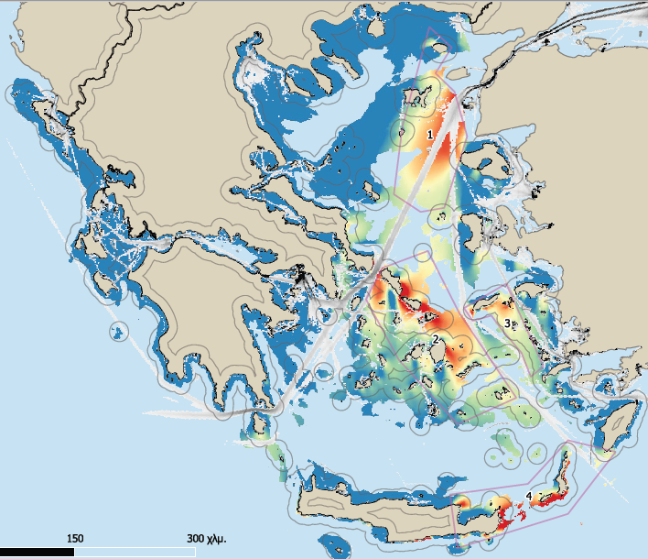
Particularities of the Greek Maritime Area for OWF
Deep sea waters
with favorable metocean conditions
(map showing water depth up to 500m)

Slide 4
Preconditions for a Successful Offshore Wind Energy Deployment in Greece
Necessary conditions for achieving the NECP goals are:
A complete legislative and regulatory framework to support investments
Good knowledge of the external conditions at the areas of interest to derisk investments (metocean, geophysical, geotechnical)
A strong technological base and relevant experience by the potential developers
A ready to support supply chain (ports, shipyards, vessels and necessary infrastructure)
Human resources and capacities along all links of the supply chain

Slide 5
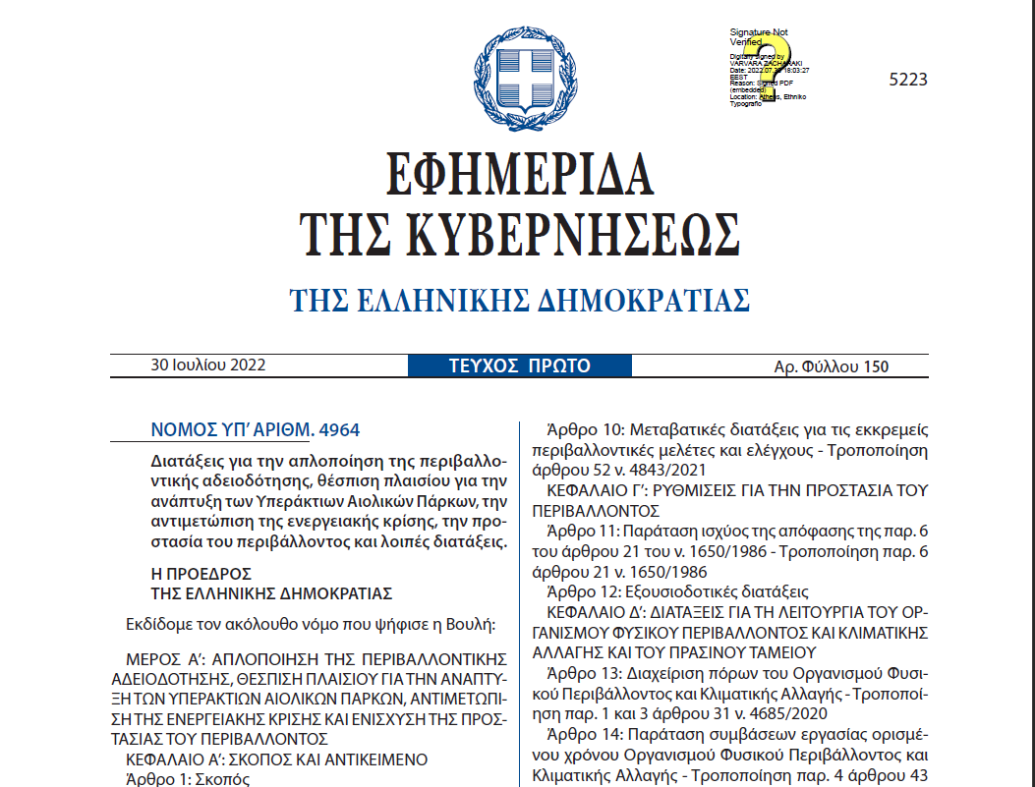
Law 4964/2022 opens the offshore wind market – the main steps
National Program for Offshore Wind Development after a Strategic Environmental Impact Assessment (SEIA) identifies planned Offshore Wind Farm Organized Development Areas (OWFODA).
Presidential Decree (PD) will define the terms of OWF development in each approved OWFODA after a Strategic Environmental Impact Assessment (SEIA).
Granting of non-exclusive Exploration Licenses in each OWFODA to interested parties (on/off technical and financial criteria, submission of letter of guarantee 10k€/MW).
Research Period to the permitted parties (for max 3years right to elaborate measurements and studies within each OWFODA).
Definition of specific Installation Areas in each OWFODA (Ministerial Decision that will include inter alia an assessment of the maximum installed capacity in each Installation Area)
Auction for Operational Aid (CfD type PPAs) by Regulatory Authority of Energy (RAE) among entities that have Exploration License (right of permitted entities to submit a bid for each Installation Area within the OWFODA).
Granting of Exclusive Right to license and develop each Installation Area to the lowest bidder

Slide 6
Legislative Framework - Τhe Basic Stages of the OWF Framework
NDP-OWF & SEIA
JMD for NDP-OWF
OWFODA SEIA & Presidential Degree
RESEARCH PERMIT
RAE COMPETITIONS
The National Program for the Development of OWF includes the OWFODAs.
HEREMA takes care of the preparation of a Strategic Environmental Impact Assessment.
With a Joint Ministerial Decision, the National Offshore Wind Farm Development Program (NDP-OWF) is approved, together with the Strategic Environmental Impact Assessment.
For each OWFODA, a technical study is prepared which is subject, under the responsibility of HEREMA, to an environmental impact assessment process through a Strategic Environmental Impact Study.
Subsequently, OWFODA is established by Presidential Decree.
The interested investor submits a request for an Offshore Wind Farm Research Permit. By decision of HEREMA, the criteria of professional and technical ability and financial and economic adequacy of the applicants are specified.
The Energy Regulatory Authority (RAE) is announcing a competitive tendering process for the granting of operational support to the OWF Projects that will be developed within the OWF Installation Areas.
01
02
03
04
05

Slide 7
The OWF National Program – The potential OWFODA Areas
areas for medium-term development
areas for medium-term development
of them for floating wind )
of them for floating wind )
Pilot projects ( Pilot 1 & 2)
Pilot projects ( Pilot 1 & 2)
Up to 600 MW / 353
Up to 600 MW / 353
areas for long-term development
areas for long-term development
of them for floating wind )
of them for floating wind )
The National Offshore Wind Farm Development Plan, determines the total marine area that has a potential for exploitation. It has been prepared by HEREMA, it was published in October 2023 and will be typically approved within 2024.

Slide 8
Legislative Framework – Next steps (1/2)
The next steps for the legislative framework are:
The typical approval of the National Offshore Wind Farms Development Program (NDP-OWF) which determines the total marine area that is in principle suitable for the relevant exploitation. The NDP-OWF has been prepared by HEREMA and will be typically approved with the issuance of a Joint Ministerial Decision.
The NDP-OWF covers different phases of development of the OWF. Phase I covers at least the target until 2030, and Phase II covers the target until 2050 with an intermediate target for 2035.
The selection of the first Offshore Wind Farm Organized Development Areas (OWFODA), in which the first wind farms will be installed. The first OWFODA will be approved by Presidential Decree and will cover the target of 1.9 GW. The marine area south of Alexandroupolis (Pilot projects), has already been approved as OWFODA.

Slide 9
Legislative Framework – Next steps (2/2)
The approval by the European Commission of the aid scheme which has already been pre-notified, and its implementation.
The scheme provides for operational support through a 20-year Contract for Differences following participation in competitive bidding processes.
By 2027, the process of selecting and identifying the second OWFODA package will have begun, which will cover the intermediate goal of 2035.
At the same time, the National Program will be reviewed before 2030 in order to adapt Phase II (after 2035) to new technological and economic circumstances.
The System Operator has already booked grid capacity for the 2030 target

Slide 10
Mapping the external conditions – Status and next steps
Presently no field measurements available in the OWFODA areas. Metocean (wind, waves, currents), geophysical and geotechnical data are required.
Model-generated metocean data (wind and wave characteristics) are available through free access databases (GWA, ERA5, NEWA, Copernicus Marine) but they come with high uncertainty if directly used for investment planning.
For reasons of maturity of the licensing process, HEREMA undertook to conduct research (or assign it to a special purpose vehicle), and to carry out the necessary measurements and collect data required for the design, development, installation and operation of offshore wind farms in selected areas identified in the National Offshore Wind Farm Development Program. This work is in progress.

Slide 11
Technological basis and relevant experience – Status and next steps
There is no offshore wind farm, not even a demo wind turbine, currently operating in Greece.
Greek developers are highly experienced on onshore wind farms development but not on offshore. Multinational companies with a Greek branch are ready to act in the Greek offshore wind market. Others will borrow the needed knowhow through joint ventures with experienced players from abroad.
Greek construction companies, large machinery shops, shipyards and cable manufacturers do have the needed expertise and capacity to manufacture support structures and supply balance of plant components.
Research Institutes, Universities and Engineering Consultants have strong background and knowledge for the design and analysis of offshore wind turbines and wind farms.
The design, construction and demonstration of a floating wind turbine, studied and manufactured by Greek stakeholders, would boost their capabilities and mobilize the local supply chain for maximizing the domestic added value to offshore wind investments.

Slide 12
Local supply chain– Status and next steps
A workshop on the challenges and prospects for the development of the domestic supply chain for Offshore Wind was held In November 2023. The Workshop was organized by ELETAEN in collaboration with Norwegian Offshore Wind NOW and supported by EEA grants.
Over 65 companies from Greece, Norway and other countries discussed in detail in a full-day program. It was the first time that companies from the entire supply chain for OW have come together in the same venue to meet each other, exchange experiences and know-how and consider how they can plan the next steps.
During the workshop, ELETAEN and its partners presented two studies:
– The study on the technical requirements of the sites for the construction of the offshore wind farm equipment
– The results of the market research which was executed using a questionnaire and interviews with business executives in Greece involved in the supply chain
A key conclusion is that there are many challenges for the development of the domestic supply chain for OW, but at the same time there are significant potential and opportunities.
The early mobilization of the supply chain actors, in particular ports and shipyards, in terms of permitting actions and infrastructure investments is critical for maximizing the domestic added value of offshore wind development in the country.

Slide 13
Human resources and capacities
“Global Wind Organization (GWO) and Global Wind Energy Council (GWEC) have published their most recent report, ‘Global Wind Workforce Outlook 2023 – 2027’ forecasting the numbers of wind technicians required to construct, install, operate, and maintain (C&I and O&M) the anticipated global wind fleet up to 2027.
Insights reveal promising career developments within the wind market, with increasing demand for new technicians over the next five years, suggesting a raft of exciting opportunities for new talent to enter from full-time education and to transition from other sectors.
The news not only underscores the extent of the workforce needed but also emphasizes the opportunities for local and national governments to use renewable energy expansion as a catalyst for job creation, training, and reskilling.
By 2027, it is projected that more than 574,000 technicians will be required for the construction, installation, operation, and maintenance of wind projects globally, following the rapid expansion of the offshore wind market. The surge in annual wind energy installations, set to double from 78 GW in 2022 to 155 GW in 2027, is a key driver for this demand.”
https://www.gevwindpower.com/wind-industry-news/technicians-in-demand/

Slide 14
www.eletaen.gr
www.ask4wind.gr

