Slide 1
Planning for Floating Offshore Wind - based on experience

Slide 2
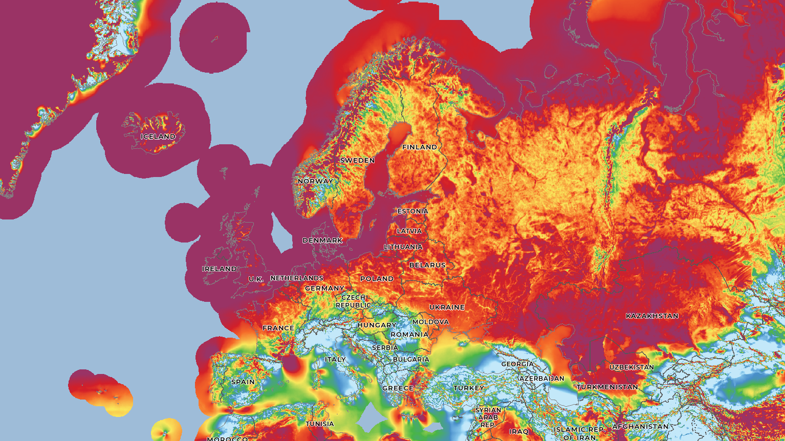
Notes:
Paris goals
Energy trilemma; reliable, affordable, and sustainable energy
Electricity is the obvious answer
Wind map

Slide 3
30GW of offshore wind concession areas has been identified
GoliatVIND
Nordavind C
FOW
Nordavind D
FOW
Nordavind B
FOW
FOW
Nordavind A
The Norwegian Water Resources and Energy Directorate (“NVE”) is a directorate under the Ministry of Petroleum and Energy
NVE is responsible for the management of Norway’s water and energy resources and for maintaining national power supplies
In April 2023, NVE published 20 offshore wind areas for further research as part of their assignment from the Ministry of Petroleum and Energy
NVE was able to identify up to 30GW in potential development areas, mainly for floating offshore wind (85%), with ambition to be awarded by 2040
Nordvest A
FOW
Apart from the two previous identified areas Sørlige Nordsjø II (part of Sørvest F) and Utsira Nord (part of Vestavind F), NVE has identified 18 additional areas in the North Sea suited for offshore wind
85% of these areas requires floating wind technology, representing a huge potential for floating offshore wind technology in Norway
Nordvest B
2
20
FOW
Nordvest C
Offshore wind areas prior to April 2023¹
Identified areas published April 2023
FOW
Vestavind A
FOW
Vestavind B
FOW
Vestavind C
Vestavind D
UtsiraVIND
85%
+60,000km²
30GW
2025
Vestavind F
Identified offshore wind area
Vestavind E
FOW
FOW
Floating wind
of the locations require floating wind
suitable for developing offshore wind
total development potential by 2040
next offshore wind area(s) allocation¹
Sørvest A
FOW BF
Sørvest B
Sørvest E
FOW BF
Floating / bottom fixed
BF
FOW BF
FOW BF
Sønnavind A
Sørvest C
BF
BF
Bottom fixed
FOW BF
Sørvest F
Sørvest D

Slide 4
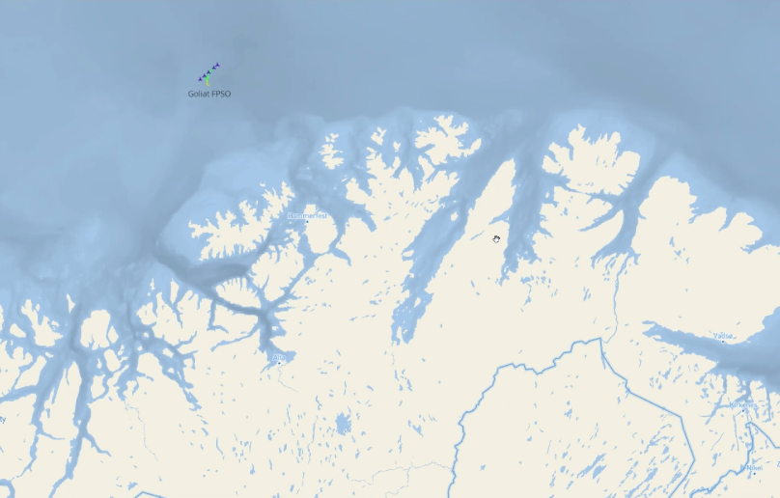
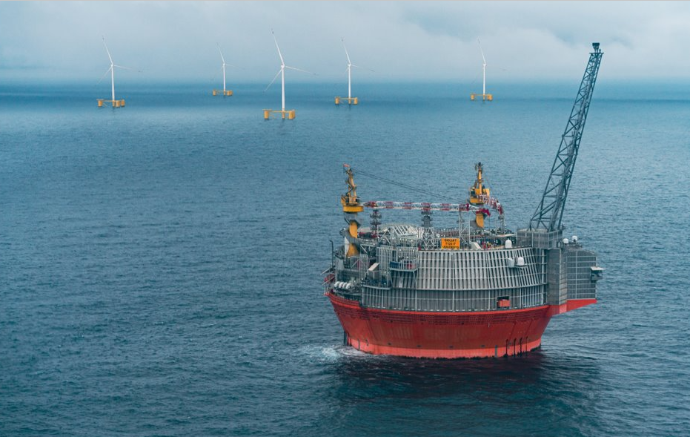
Floating Wind Project
75 (5x15) MW
COD 2027
300 GWh

Slide 5
Main takeways
Governmental & Public
Floating Offshore Wind as export industry / employments / value creation
Add resources and competence to the Governmental bodies that will deal with FOW
Qualitative criteria's creates an early incentive for supply chain investments
Governmental surveys and desktop for the developers.
Developers
Find common interest – work together. Share data!
Joint Industry Project to gain more data faster (for instance Lidar).
Provide analysis and solutions to the Government.
Develop «right size» projects in according to the maturity of the industry.
Form strong and competent consortia early on.
Make technology choices and schedule in project financing process and requirements.
Strategy Early movers; Supply chain packages vs EPMA
Lead time > 2 years; WTG, Heavy lift, cables, HV equipment, hull ++

Slide 6
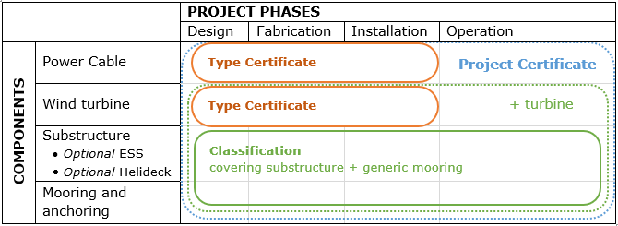
Supply chain strategy
Competence within the consortia
Realistic schedules with float to accommodate eventualities.
Sufficient available capacity with main contractors
Cost awareness with fixed pricing whenever possible.
Control and potential prior commitments of Long Lead Items in order to maintain overall schedule.
Detailed control of technology readiness levels for new technology and specific plans for technology development with back-up plans if the technology does not achieve the expected approvals.
Risk assessment and mitigating actions

Slide 7
2022/Mar
2022/Jul
2022/Sep
2022/Dec
Kickoff Meeting
KPIs Defined
Jan 28 - Mar 31
Jul 13 - Sep 30
Feb 17 - Mar 31
Oct 21 - Dec 25
Jan 2 - Mar 31
Jun 4 - Jul 11
Feb 23 - Apr 7
Apr 2 - Apr 28
Apr 2 - Jun 10
Jul 7 - Sep 14
Aug 3 - Oct 28
Sep 1 - Oct 21
Apr 2 - Jun 2
Feb 2 - Apr 7
Jun 5 - Aug 5
Apr 1 - Sep 1
44.8 days
56.4 days
43.5 days
30.4 days
18.3 days
62.2 days
63.8 days
44.5 days
45.9 days
26 days
46 days
50 days
50 days
7.1 wks
Dec 20
Aug 10
Oct 19
May 19
Oct 18
Dec 21
Jan 16
Mar 31
Mar 31
Jul 28
2022
Apr 1
Jun 7
75%
75%
75%
75%
Today
Financing & Due Diligence Process
2022
Finance Workstreams
IA – Sets Target IRR and necessary CFD rate.
Phasing of spend pre FC to be submitted into Corporate Budget/Cashflow Processes
Tech DD will assess design, yield, supplier contracts, risk allocation, pricing, program delivery. Docs to be reasonably mature draft at minimum to open Data room
Pre DG2
Development → Ready to Build (RTB)
Final Investment Decision (FID)
Financial Close (FC)
Preliminary Model
Investment Appraisal
Update with external estimates
Update with final assumptions
Model Audited & Locked
Market Soundings
Appoint Mandated Lead Arranger (MLA)
Project Financing – Debt
Lender Competition, Group assembled
Binding Term Sheet negotiated, Exclusivity Granted
Financing Documents Negotiated
Lender Credit Approval
Agree Scope, Run RFP, Appoint Advisors
Project Due Diligence
Data room Populated
Data room Updated
Draft Reports – Tech, Legal, Insurance, Market
Negotiated Final DD Reports
Conditions Precedent Discharged
Sponsors Equity
Size, Structure. Phase
Sponsor Equity Requirement
Sponsor Capital Contributions and Additional Equity Fund Raise
Equity Contribution to SPV @ FC

Slide 8
Thank you!
Gunnar Birkeland
CEO
Source Galileo Norge AS
+47 90981029
gunnar.birkeland@sourcegalileo.com

