Slide 1
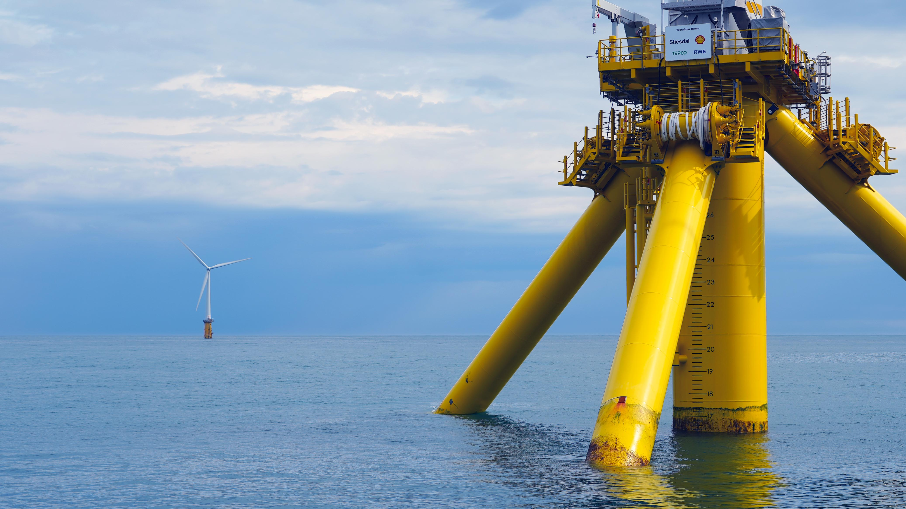
Competence and skill needs
Case Norway

Slide 2
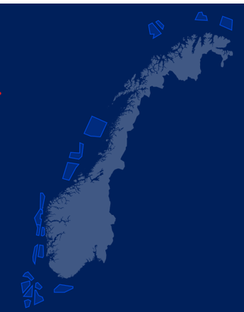
Expected economic activity
Offshore wind ambitions - 30 GW offshore wind power in Norway by 2040
Export ambitions - 10 percent share of the global offshore wind market by 2030,
Status today: Turnover – ca 3 BN Euros
  1.5 BN Euros – in Norway
  1.4 BN Euros – outside Norway
2030 – 8.5 Bn Euros annually

Slide 3
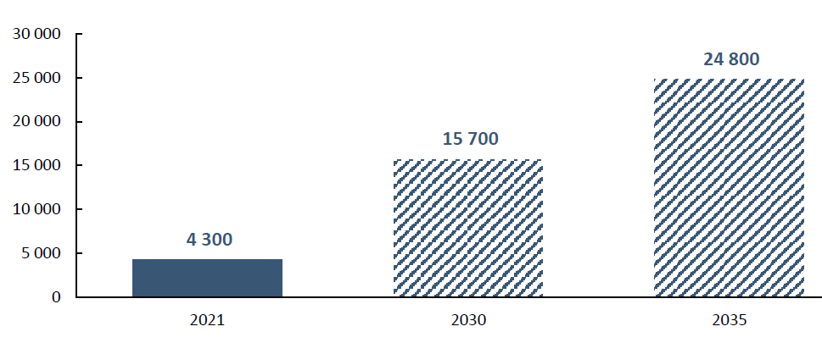
Expected need for employees by education level for the offshore wind industry
Scale:
Today: 4300 (FTE) in offshore wind
2030: 16 000 (FTE)
2035: 25 000 (FTE)
2050: 100 000 (FTE)????

Slide 4


Slide 5

Supply chain
Offshore Wind Developers
 | EPCI
Development & engineering | Turbine supply | Balance of plant | Installation & commissioning | Operation & maintenance | Life time extension & decommissioning | Ecosystem
Site investigation and surveys | Marshalling yards | Turbine foundations | Turbine installation | Maintenance services | Life time extension | Law
Design and engineering | Turbine logistics | Assembly yards | Foundation installation | Inspection services | Decommissioning | Finance
Project management | Drive chain | Electrical cables | Offshore and onshore cable installation | Vessels |  | Marketing
Consenting and development services | Power conversions and supplies to the turbine | Electrical systems | Offshore and onshore substation installation | O & M ports |  | Digitalisation and systems
 |  | HVAC/HVDC/Substations | Installation port | Training and certification |  | Universities and research institutions
 |  | Secondary steel work | Installation logistics | Monitoring |  | Government and other public institutions
 |  | Mooring | Commissioning
 |  | Equipment for foundation and transition piece
Notes:
Consisting of strong developers and a supply chain with large contractors as well as niche suppliers.

Slide 6
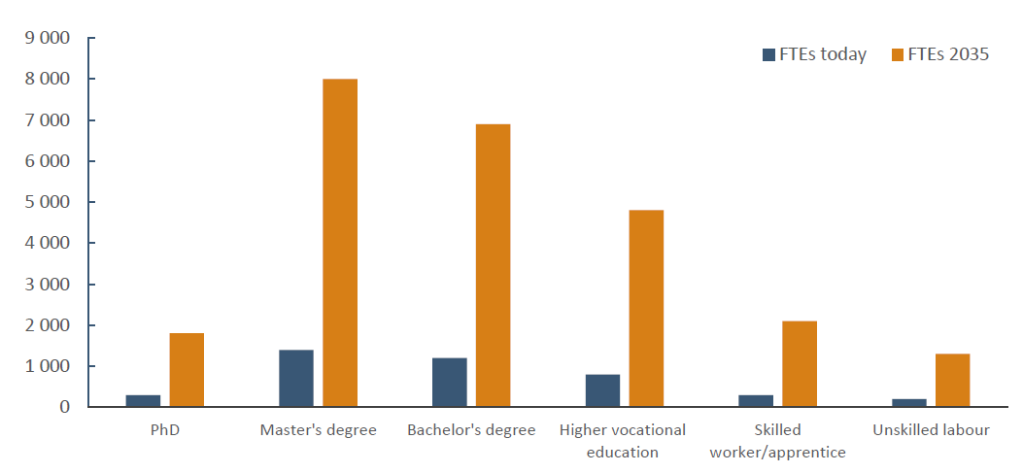
Scope: Expected need for employees by education level for the offshore wind industry, today and in 2035
Notes:
EPCI-leverandører, eiere/operatører og tjenesteleverandører har en forventing om at høyere utdanning (PhD, MSc og BSc) vil utgjøre
Ingeniørkompetanse: Mekanikk og energi- og offshoreteknologi er de ingeniørretningene flest aktører etterspør.

Slide 7
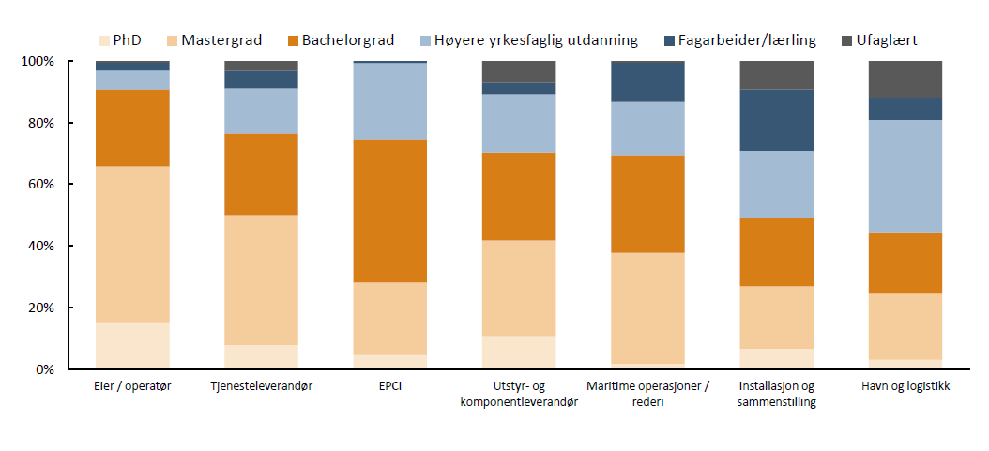
Breakdown: Education levels - supply chain differences

Slide 8
Breakdown: Education levels - types
Higher Education
Higher vocational level
Vocational level
Engineering - 40
Economical - 19
ICT - 17
Juridical - 16
Environmental etc - 7
Technological and industrial 37
Electro 17
Construction 19
ICT 14
Technological and industrial 30
Electro 38
Construction 11
ICT 21

Slide 9
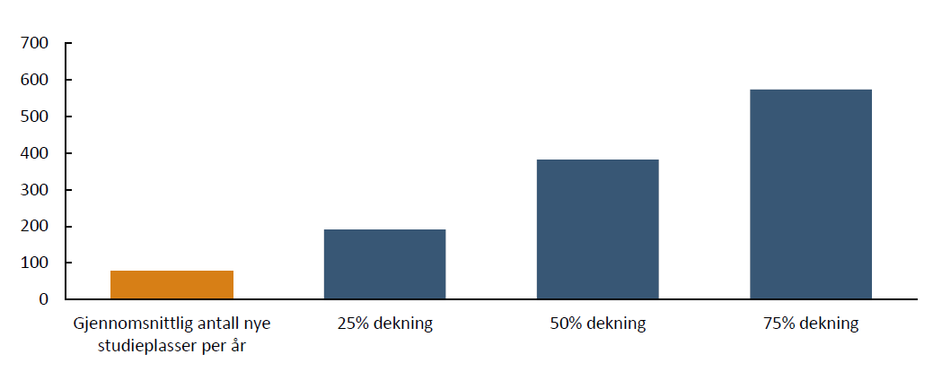
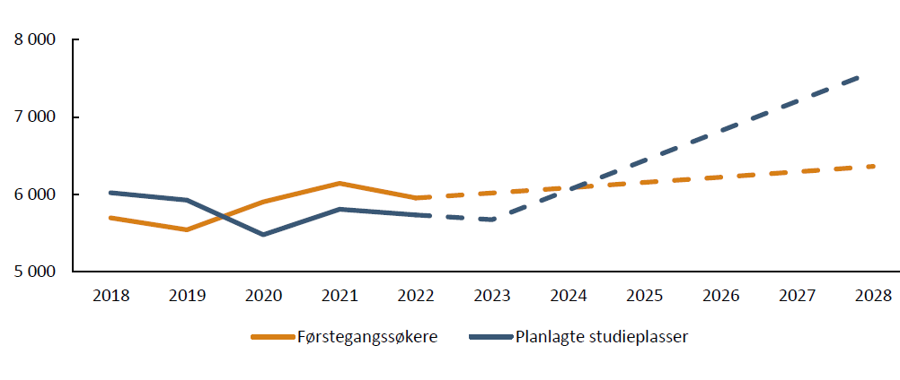
Gap in supply for admission
Gap in demand for admission

Slide 10
Some take aways
Scope: Education system is relevant compared to the skills demanded by the industry
  Generic fields such as engineering, technology, economics and information and computer technology,
  Courses specifically aimed at the offshore wind industry
Scale: Significant gap, i.e. a deficit in relevant competence, as a result of too few admission to study (study places)
Expect a 5-fold increase in offshore wind jobs by 2035. This is significant growth, but estimates do not differ significantly from the underlying trend.
Engineering and technological studies: Need to increase the number of study places by 380 annually in the period 2024 - 2028. In 2028 there will be a need for around 1,900

