Slide 1
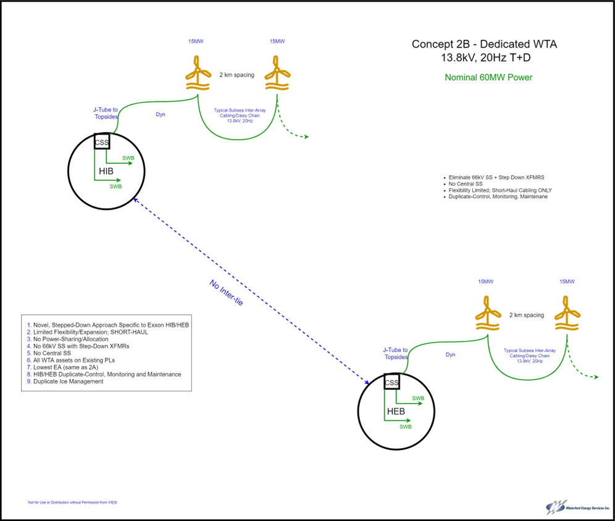
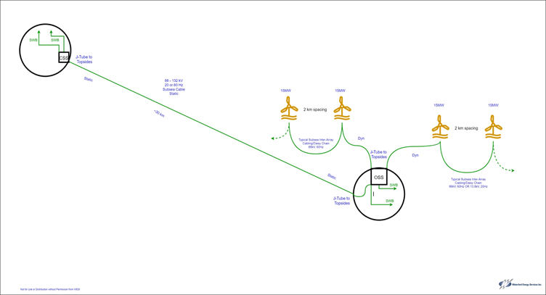
BlueWind – case study: pre-FEED in Canada
Customer Goal:
Reduce total CO2 footprint on both assets by 2030
Objectives:
Concept selection, including floater: From 5 concepts → 2 concepts → 1
Design basis development for integrating BlueWind into existing power plants
Dynamic and Transient analysis plus short circuit calculation of the best 2 concepts
Emissions reduction calculation in percentage and in CAD (Canada has CO2-taxes)
OPeX reduction – maintenance saving, fuel saving

Slide 2
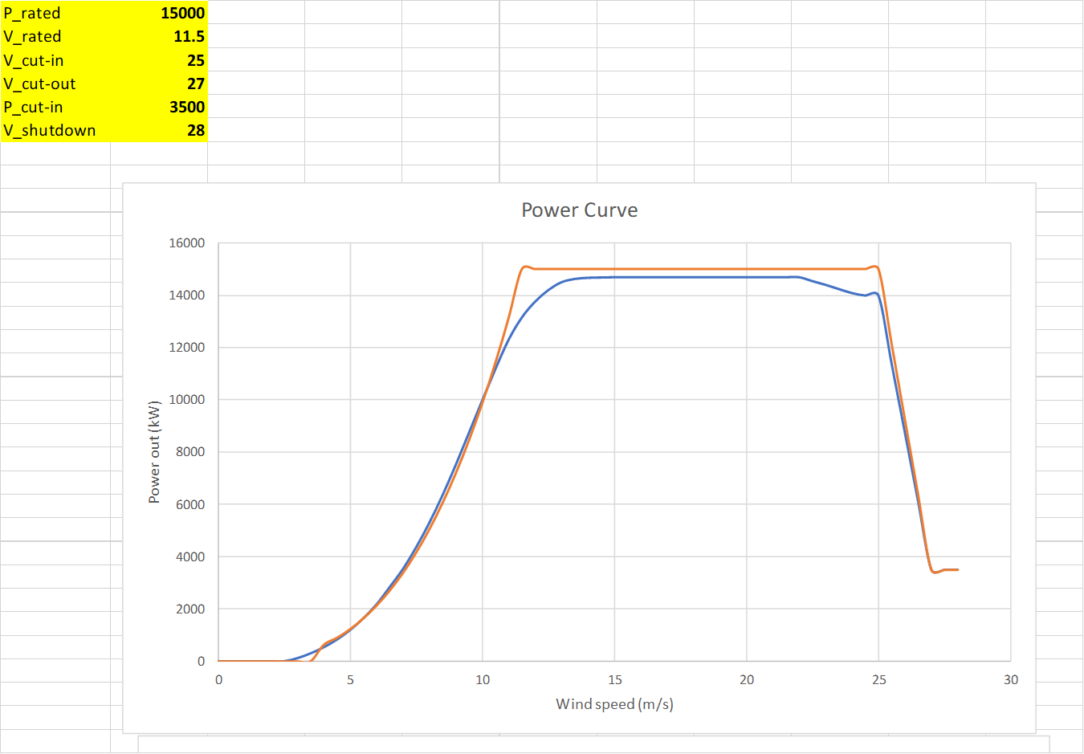
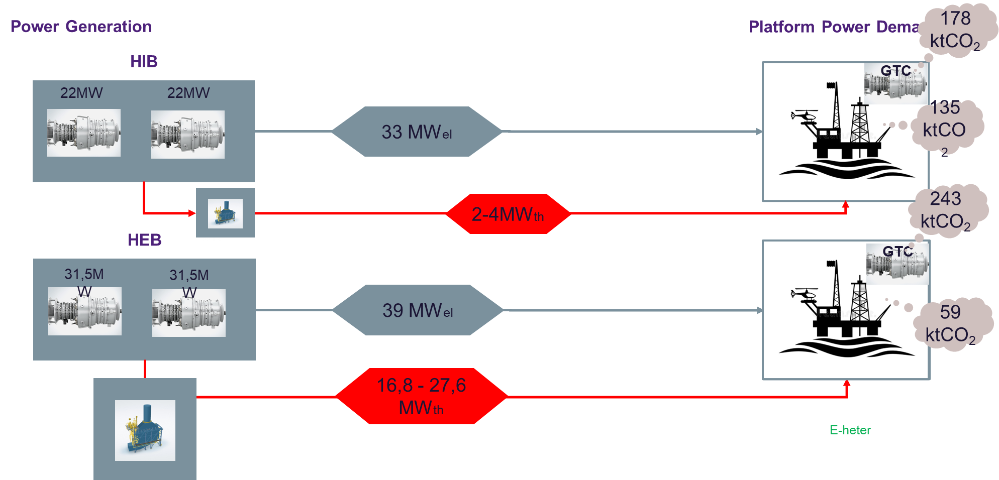
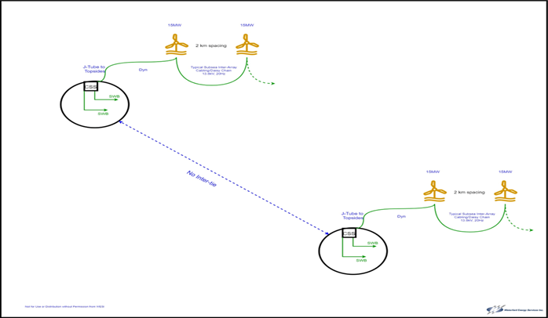
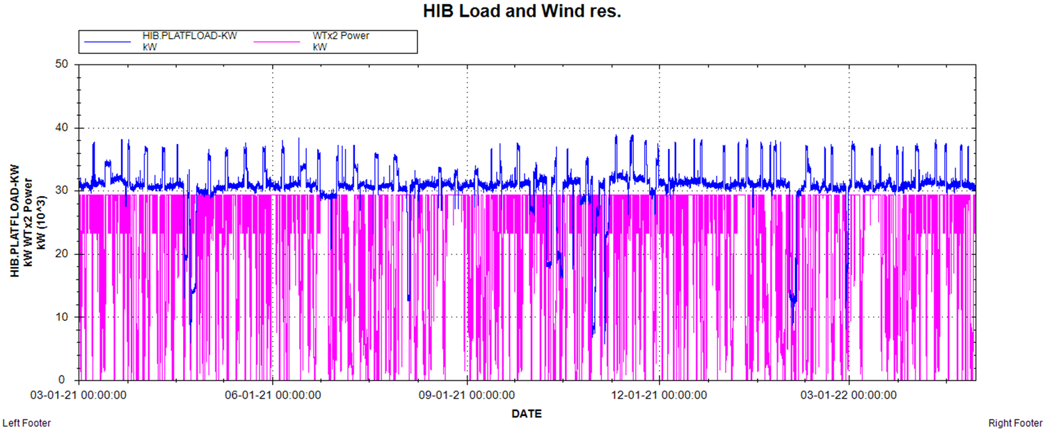
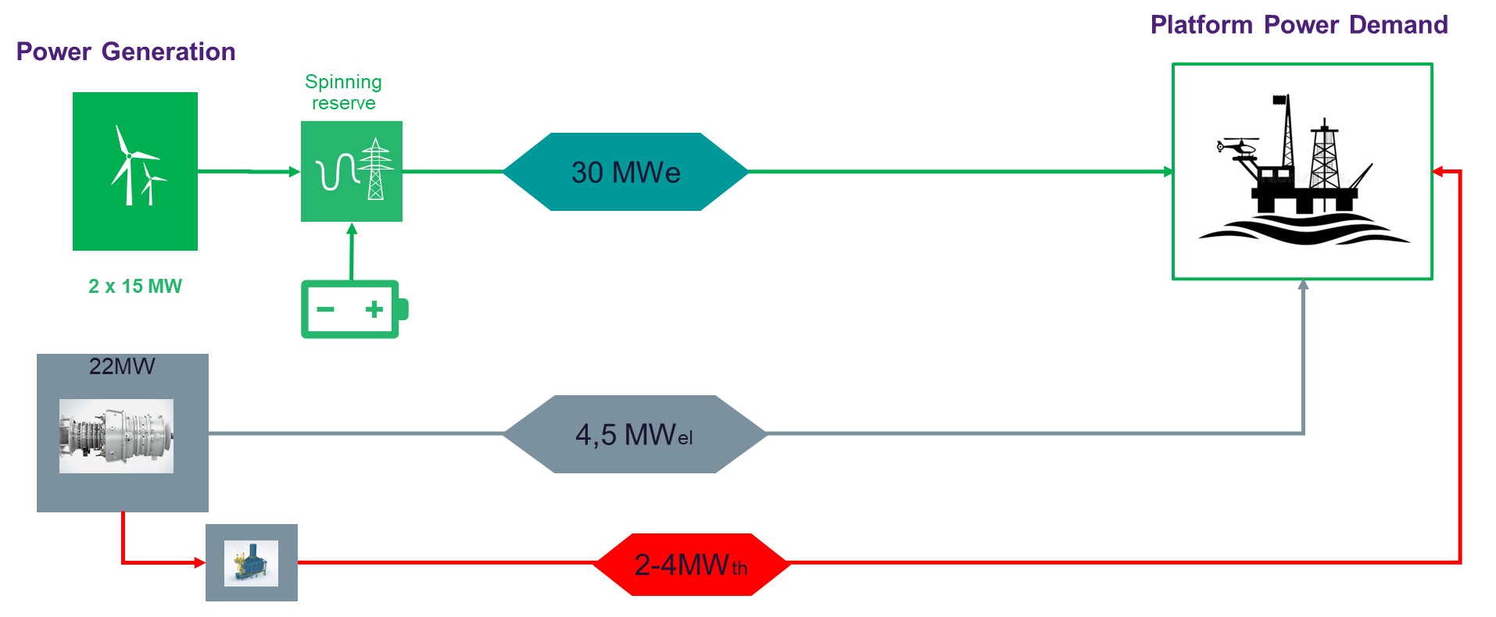
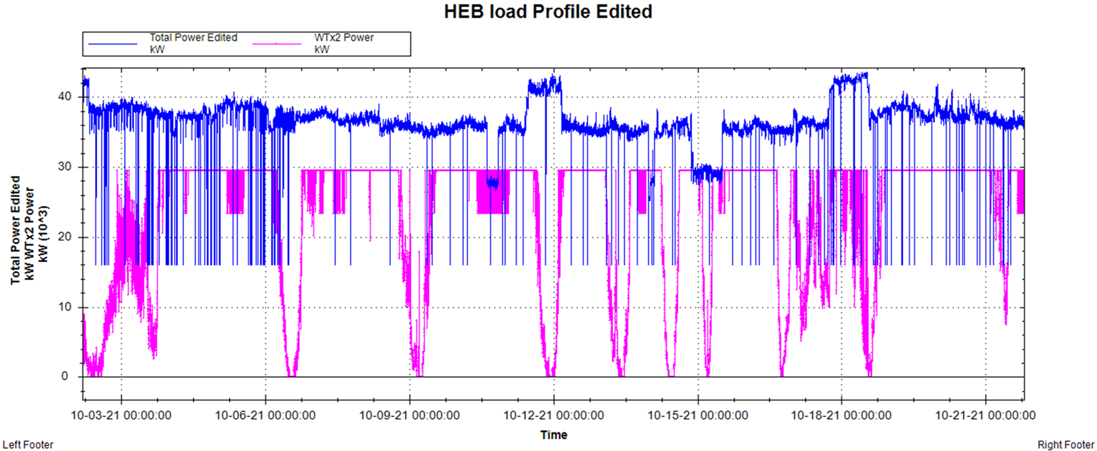
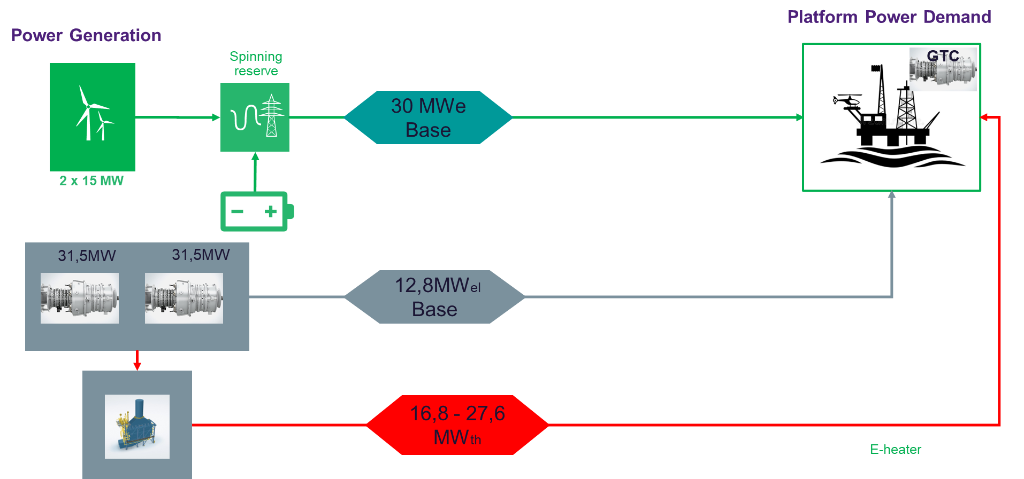
Estimated CO2 reduction: 47,6%
Methodology Solution1 Platforms separated

Slide 3
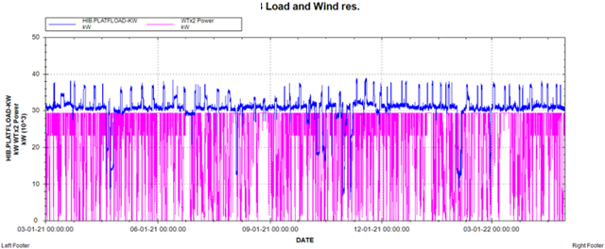
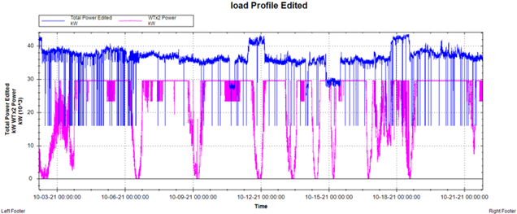
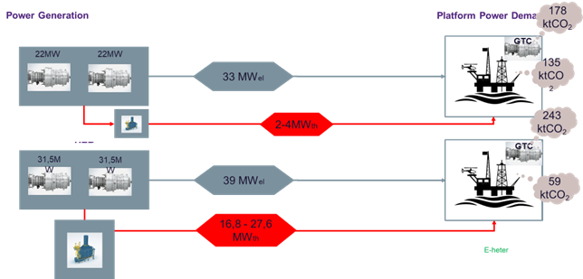
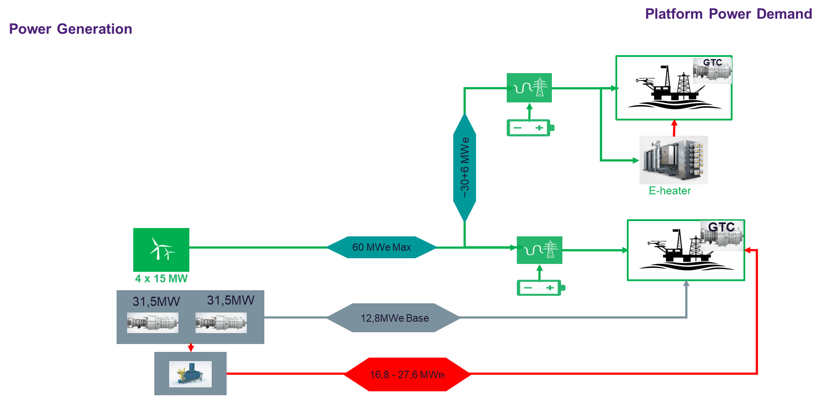
Methodology Solution 2 Platforms connected via inter-tie cable
Estimated CO2 reduction: 67,0%

