Slide 1
Assessment of the Greek Maritime Area
for the development of
Offshore Wind Farms
12th December 2022

Slide 2
Suitability assessment of the Greek Maritime Area for the Development of Offshore Wind Farms
Advantages of OW technology
Key advantages of offshore wind technology
Energy security & independence
Against climate change
OW offers locally produced energy that is independent of foreign supplies
OW produces clean and affordable energy, reducing the energy sector’s carbon footprint in the fight against climate change
1
2
Key Advantages
Energy transition
5
3
High-Capacity Factor
OW is a proven, low carbon technology, able to provide green electricity to meet national and international goals
Higher capacity factor compared to other Renewable Energy Sources (RES)
4
Successful injection in energy mix
Matches well with other RES, i.e. Solar, as more energy is produced during the night and winter complementing the overall energy production
12th December 2022
Slide 2

Slide 3
Suitability assessment of the Greek Maritime Area for the Development of Offshore Wind Farms
Added value to Greece
01
04
Contribution to national goals of decarbonization
and the reduction of GHG emissions.
Synergies with other green technologies and the formation of national and international energy centers.
02
Drive for growth in the shipyards, construction, manufacturing and equipment supply sectors.
05
RES decongestion in mainland Greece.
03
Creation of long-term new jobs of specialized human resources.
06
Direct and indirect support of local communities in the settlement areas.
12th December 2022
Slide 3

Slide 4
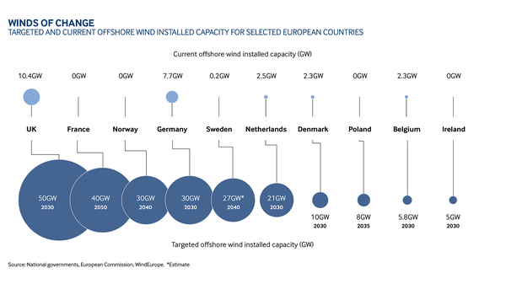
Suitability assessment of the Greek Maritime Area for the Development of Offshore Wind Farms
Advantages of OW technology
The EU strategy sets a target of installed capacity of at least 60 GW by 2030 combined of both fixed and floating technologies. The commitment to achieve these are stipulated in the Sustainable Development Goals (SDGs).
OW in Asia is expected to reach 95 GW by 2020.
The global OW capacity is expected to almost reach 233 GW by 2030.
12th December 2022
Slide 4
Notes:
Source for text on the right: EUR-Lex - 52020DC0741 - EN - EUR-Lex (europa.eu)

Slide 5
Suitability assessment of the Greek Maritime Area for the Development of Offshore Wind Farms
Main Pillars/Streams for the assessment of the Greek maritime area
01
02
03
Existing legislation in national level
Best practices and lessons learnt in international level
Cooperation and consultation with the ministries and other competent authorities
12th December 2022
Slide 5

Slide 6
Suitability assessment of the Greek Maritime Area for the Development of Offshore Wind Farms
Main Pillars/Streams for the assessment of the Greek maritime area - Existing Legal Framework
Spatial Framework for Renewable Energy Sources
Environmental Legislation
Legal Framework for Renewables
12th December 2022
Slide 6

Slide 7
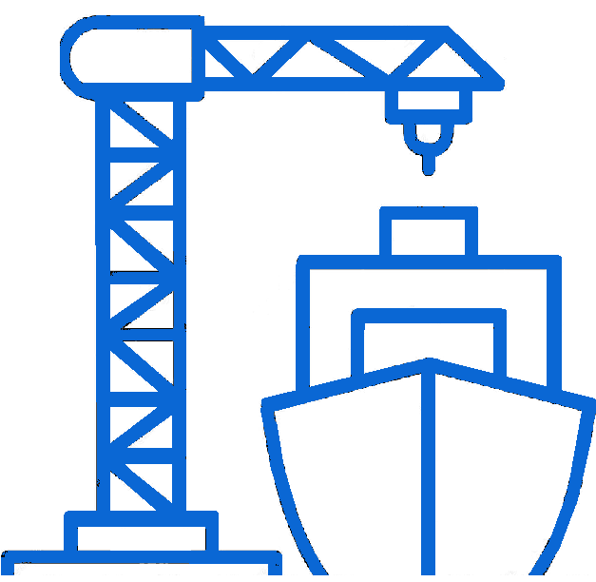
Suitability assessment of the Greek Maritime Area for the Development of Offshore Wind Farms
Main Pillars/Streams for the assessment of the Greek maritime area – Best Practices & Lessons learned internationally
Greece should benefit from lessons learned in other emerging as well as mature offshore wind markets.
There are experiences to be drawn upon as well as areas to improve that shall be adjusted in the individualities of the Greek market.
In general, there are good industry practices with respects to the regulatory regime, permitting, supply chain and marine infrastructure and the transmission network.
12th December 2022
Slide 7

Slide 8
Suitability assessment of the Greek Maritime Area for the Development of Offshore Wind Farms
Main Pillars/Streams for the assessment of the Greek maritime area – Best Practices & Lessons learned internationally
National Renewable Energy Laboratory - US
Bureau of Ocean Energy Management - US
The Crown Estate - UK
The World Bank
Danish Energy Agency
Energy research Centre of the Netherlands
Bundesamt fur Seeschifffahrt und Hydrographie (German Federal authority)
And many others within the public and private sector
12th December 2022
Slide 8

Slide 9
Suitability assessment of the Greek Maritime Area for the Development of Offshore Wind Farms
Uniqueness
Many non interconnected islands where a large proportion of the wind potential is concentrated.
Steep seabed slope and deep waters close to shore.
01
02
03
04
05
Territorial sea currently extends to six nautical miles in the Aegean sea and OW projects will be developed within such area.
Greece is a sesimic region – an issue that has not been encountered in Europe but known in other markets.
Good wind potential in combination with lower wave heights facilitating development and operational lifetime.
12th December 2022
Slide 9

Slide 10
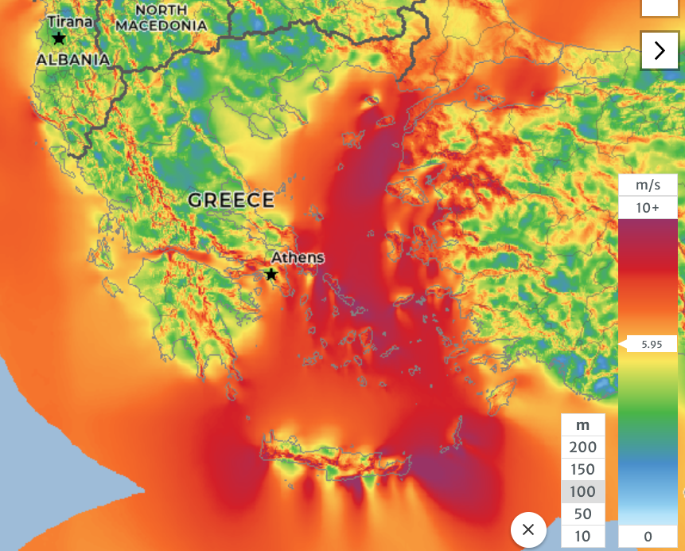
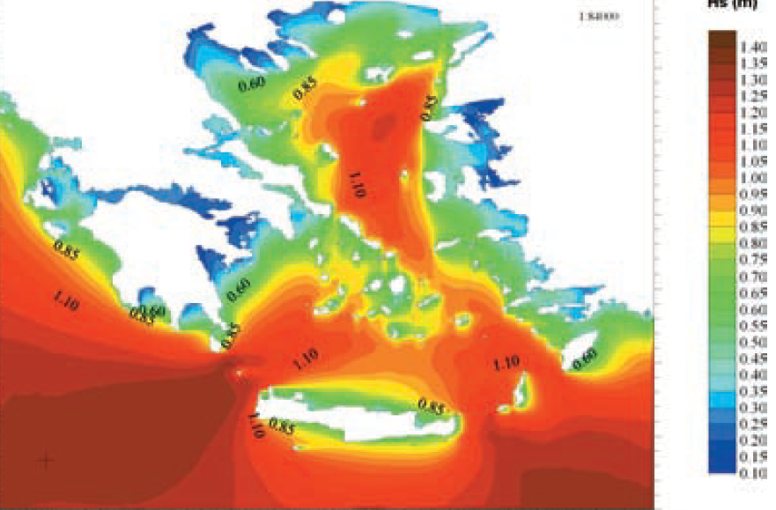
Suitability assessment of the Greek Maritime Area for the Development of Offshore Wind Farms
Unique aspects to Greece compared to other markets
Relatively rich wind resource, in particular in the Aegean sea
Favourable wave conditions, in particular when compared to the North Sea
12th December 2022
Slide 10

Slide 11
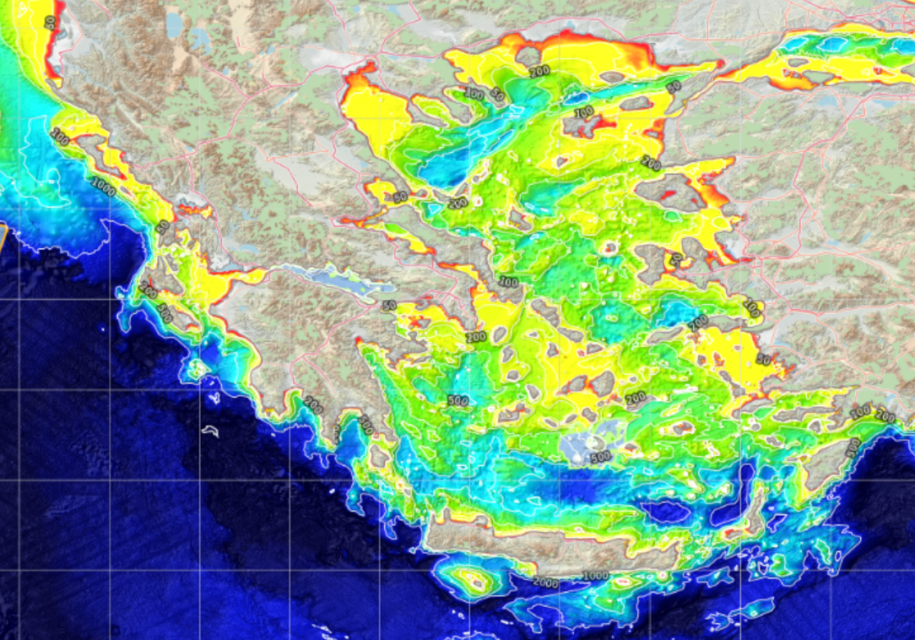
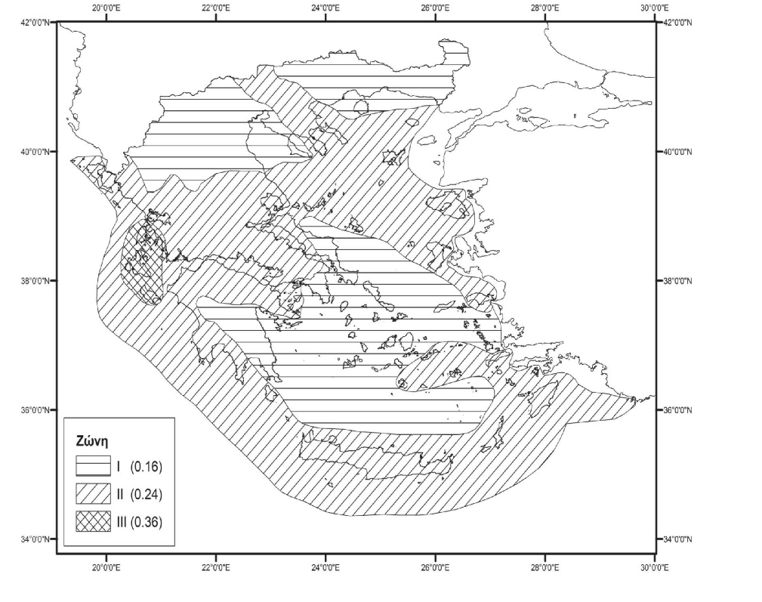
Suitability assessment of the Greek Maritime Area for the Development of Offshore Wind Farms
Unique aspects to Greece compared to other markets
Steep seabed with deep water close to coast
Seismic Activity
12th December 2022
Slide 11

Slide 12
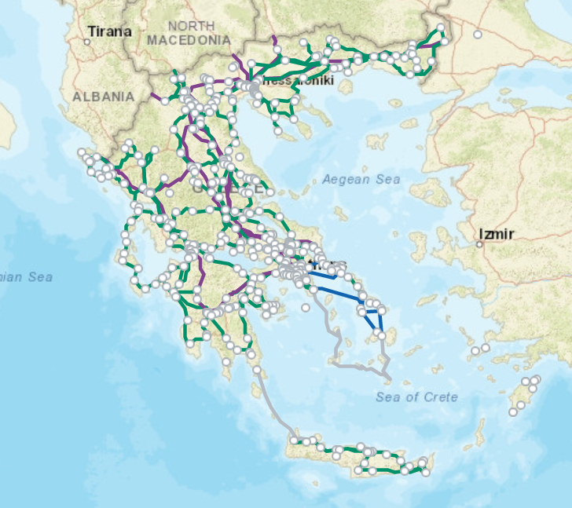
Suitability assessment of the Greek Maritime Area for the Development of Offshore Wind Farms
Unique aspects to Greece compared to other markets
Geopolitical conditions
Interconnection of islands
12th December 2022
Slide 12

Slide 13
Suitability assessment of the Greek Maritime Area for the Development of Offshore Wind Farms
Main Pillars/Streams for the assessment of the Greek maritime area – Co-operation with competent Ministries/Authorities
National Bodies & Authorities
Ministry of Environment & Energy
Competent Ministries
Ministry of Culture & Sports
Ministry of Foreign Affairs
Ministry of National Defense & Military Bodies
Ministry of Maritime Affairs And Insular Policy
Ministry of Environment And Energy
Ministry of Rural Development & Food/Fisheries Directorate
Ministry of Tourism
Civil Aviation Authority
Hellenic Centre of Marine Research
Centre of Renewable Energy Sources
I.P.T.O.
HEREMA
12th December 2022
Slide 13

Slide 14
Suitability assessment of the Greek Maritime Area for the Development of Offshore Wind Farms
Main Pillars/Streams for the assessment of the Greek maritime area – Co-operation with competent Ministries/Authorities
Ministry of National Defence
December 2022
Slide 14
Notes:
Μεθοδολογία

Slide 15
Suitability assessment of the Greek Maritime Area for the Development of Offshore Wind Farms
Identification of suitable sites
Data collection and creation of geographic layers in GIS
Collaboration with Ministries and other main Stakeholders
Application of exclusion and evaluation criteria. Selection of areas receptive to Offshore Wind Farm development
in Greek maritime area
Application of evaluation criteria for characterization and selection of optimum and prioritized
Offshore Wind Sites
12th December 2022
Slide 15

Slide 16
Suitability assessment of the Greek Maritime Area for the Development of Offshore Wind Farms
Exclusion and Evaluation Criteria
Exclusion Criteria
Evaluation Criteria
Geopolitical Criteria
Environmental Criteria related to areas of high sensitivity and protection
Criteria related to places/sites of Archaeological and Cultural interest,
Marine antiquities, Shipwrecks
Spatial Criteria related to competing uses
(existence of cities, villages, settlements, monasteries, swimming beaches,
narrow bays, areas of organized development of productive activities,
tourism areas, etc.)
Criteria in relation to telecommunication infrastructure, radars,
Aviation - distances from telecommunication infrastructure and radars
Criteria related to civil or military aviation facilities or activities
Criteria related to navigation lines
Spatial Criteria related to Aquaculture zones
Criteria in relation to military firing & exercise zones / other areas
characterized as areas of national security
Criteria related to submarine cables, networks, pipelines (Energy,
Communications, Natural Gas)
Wind data (Wind Speed, etc.)
Bathymetry
Coastline (type /morphology)
Geological and Geotechnical Data
Seismicity Data
Wave conditions
Grid Connectivity
Hydrocarbon areas
Fishing areas
Tourism
Environmental characteristics
12th December 2022
Slide 16

Slide 17
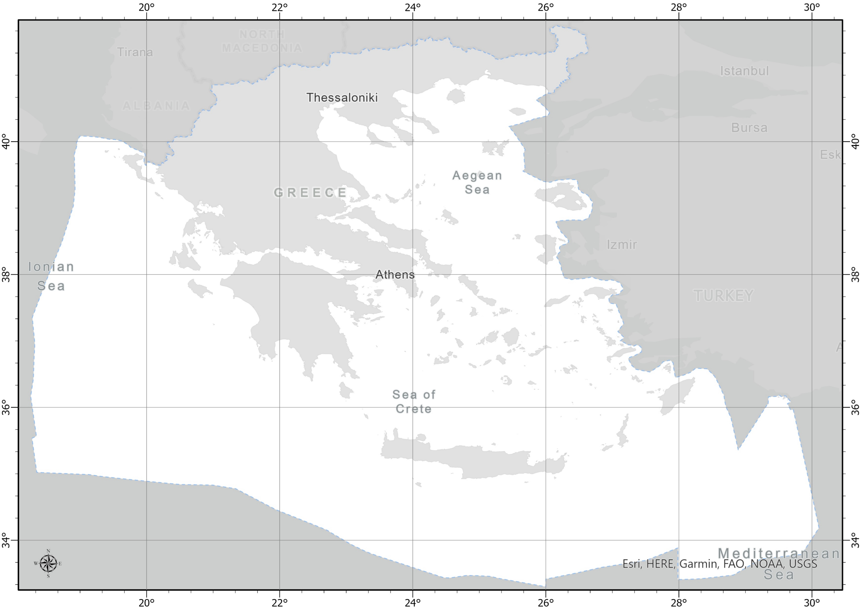
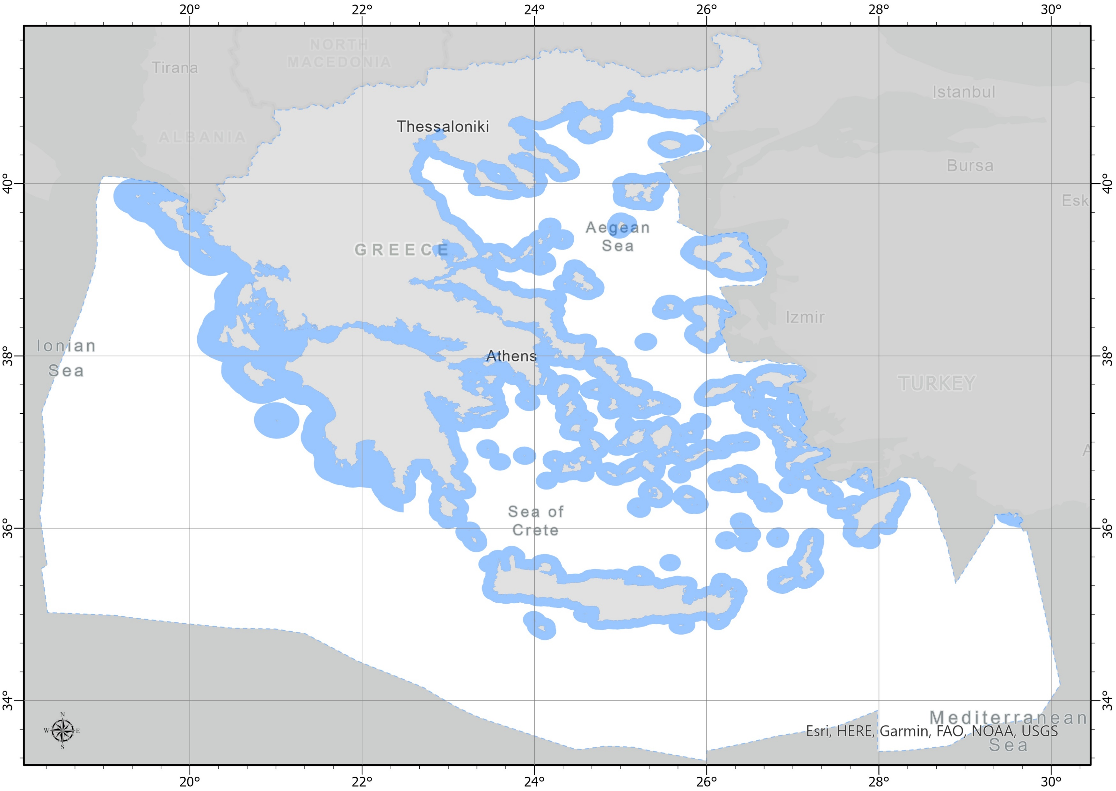
Suitability assessment of the Greek Maritime Area for the Development of Offshore Wind Farms
Site Identification – examples of applying data layers
Greek Exclusive Economic Zone (EEZ)
Nautical Miles (NM) Zones
12th December 2022
Slide 17

Slide 18
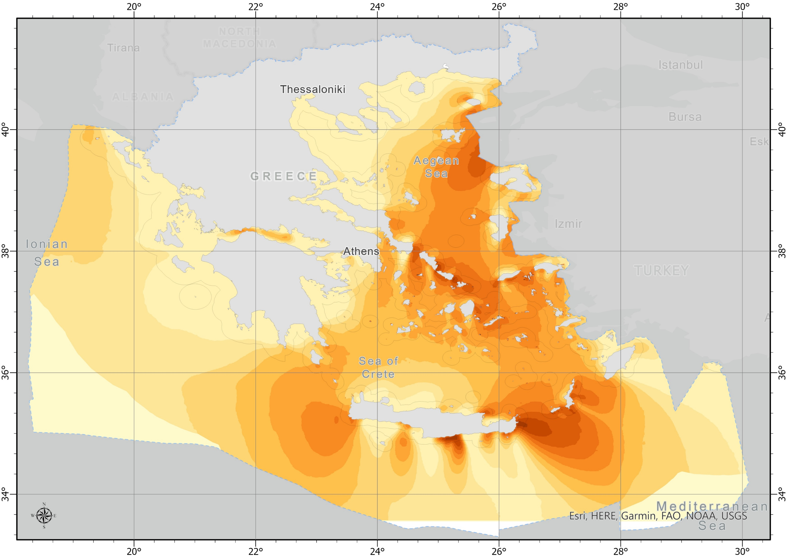
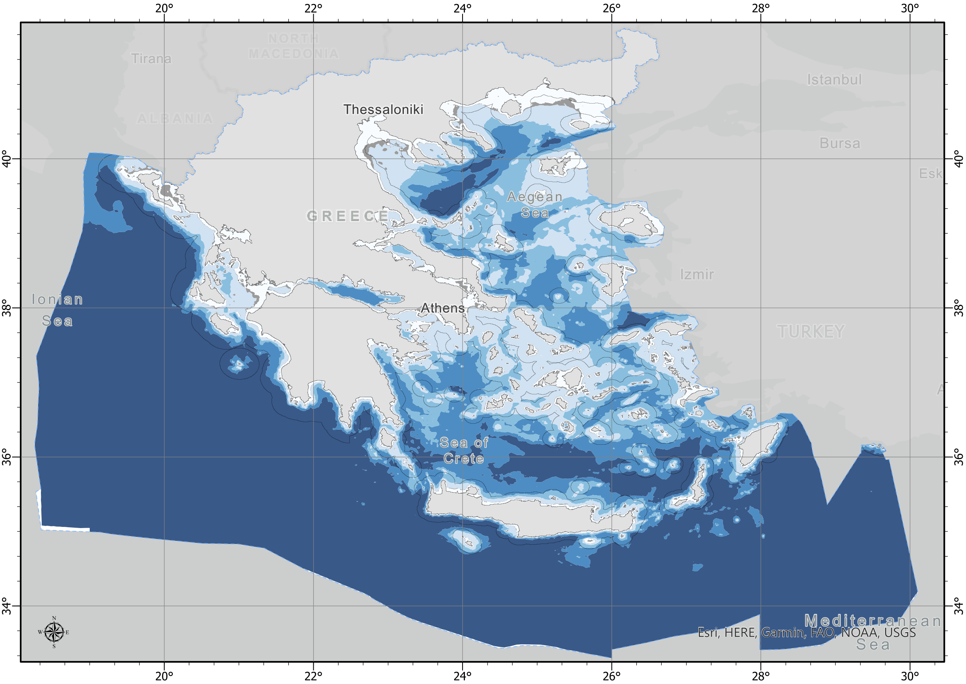
Suitability assessment of the Greek Maritime Area for the Development of Offshore Wind Farms
Site Identification – examples of applying data layers
Wind resource
Bathymetry
12th December 2022
Slide 18

Slide 19
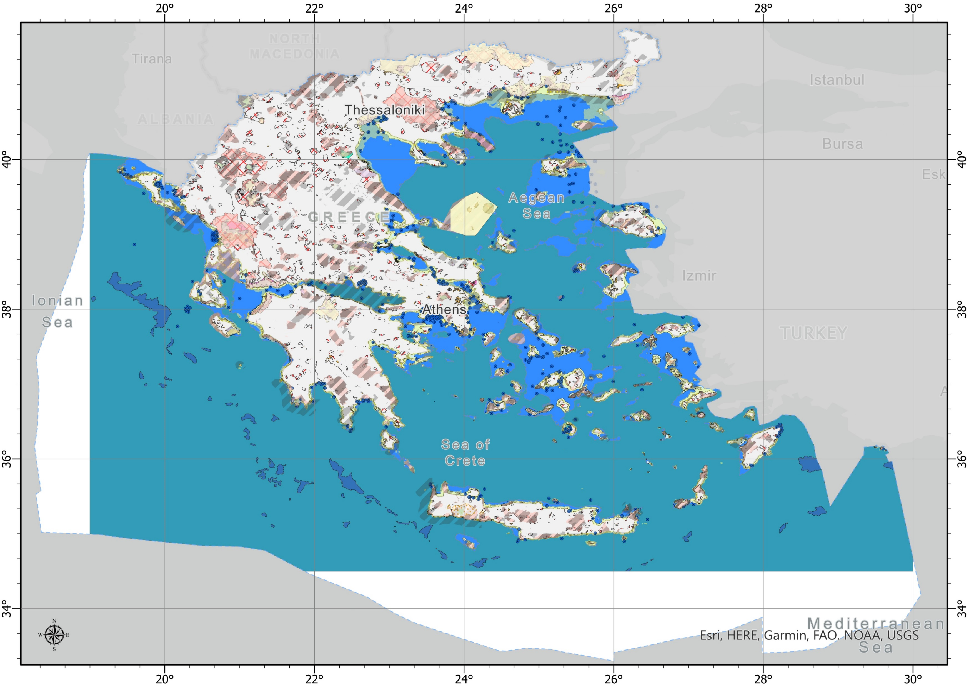
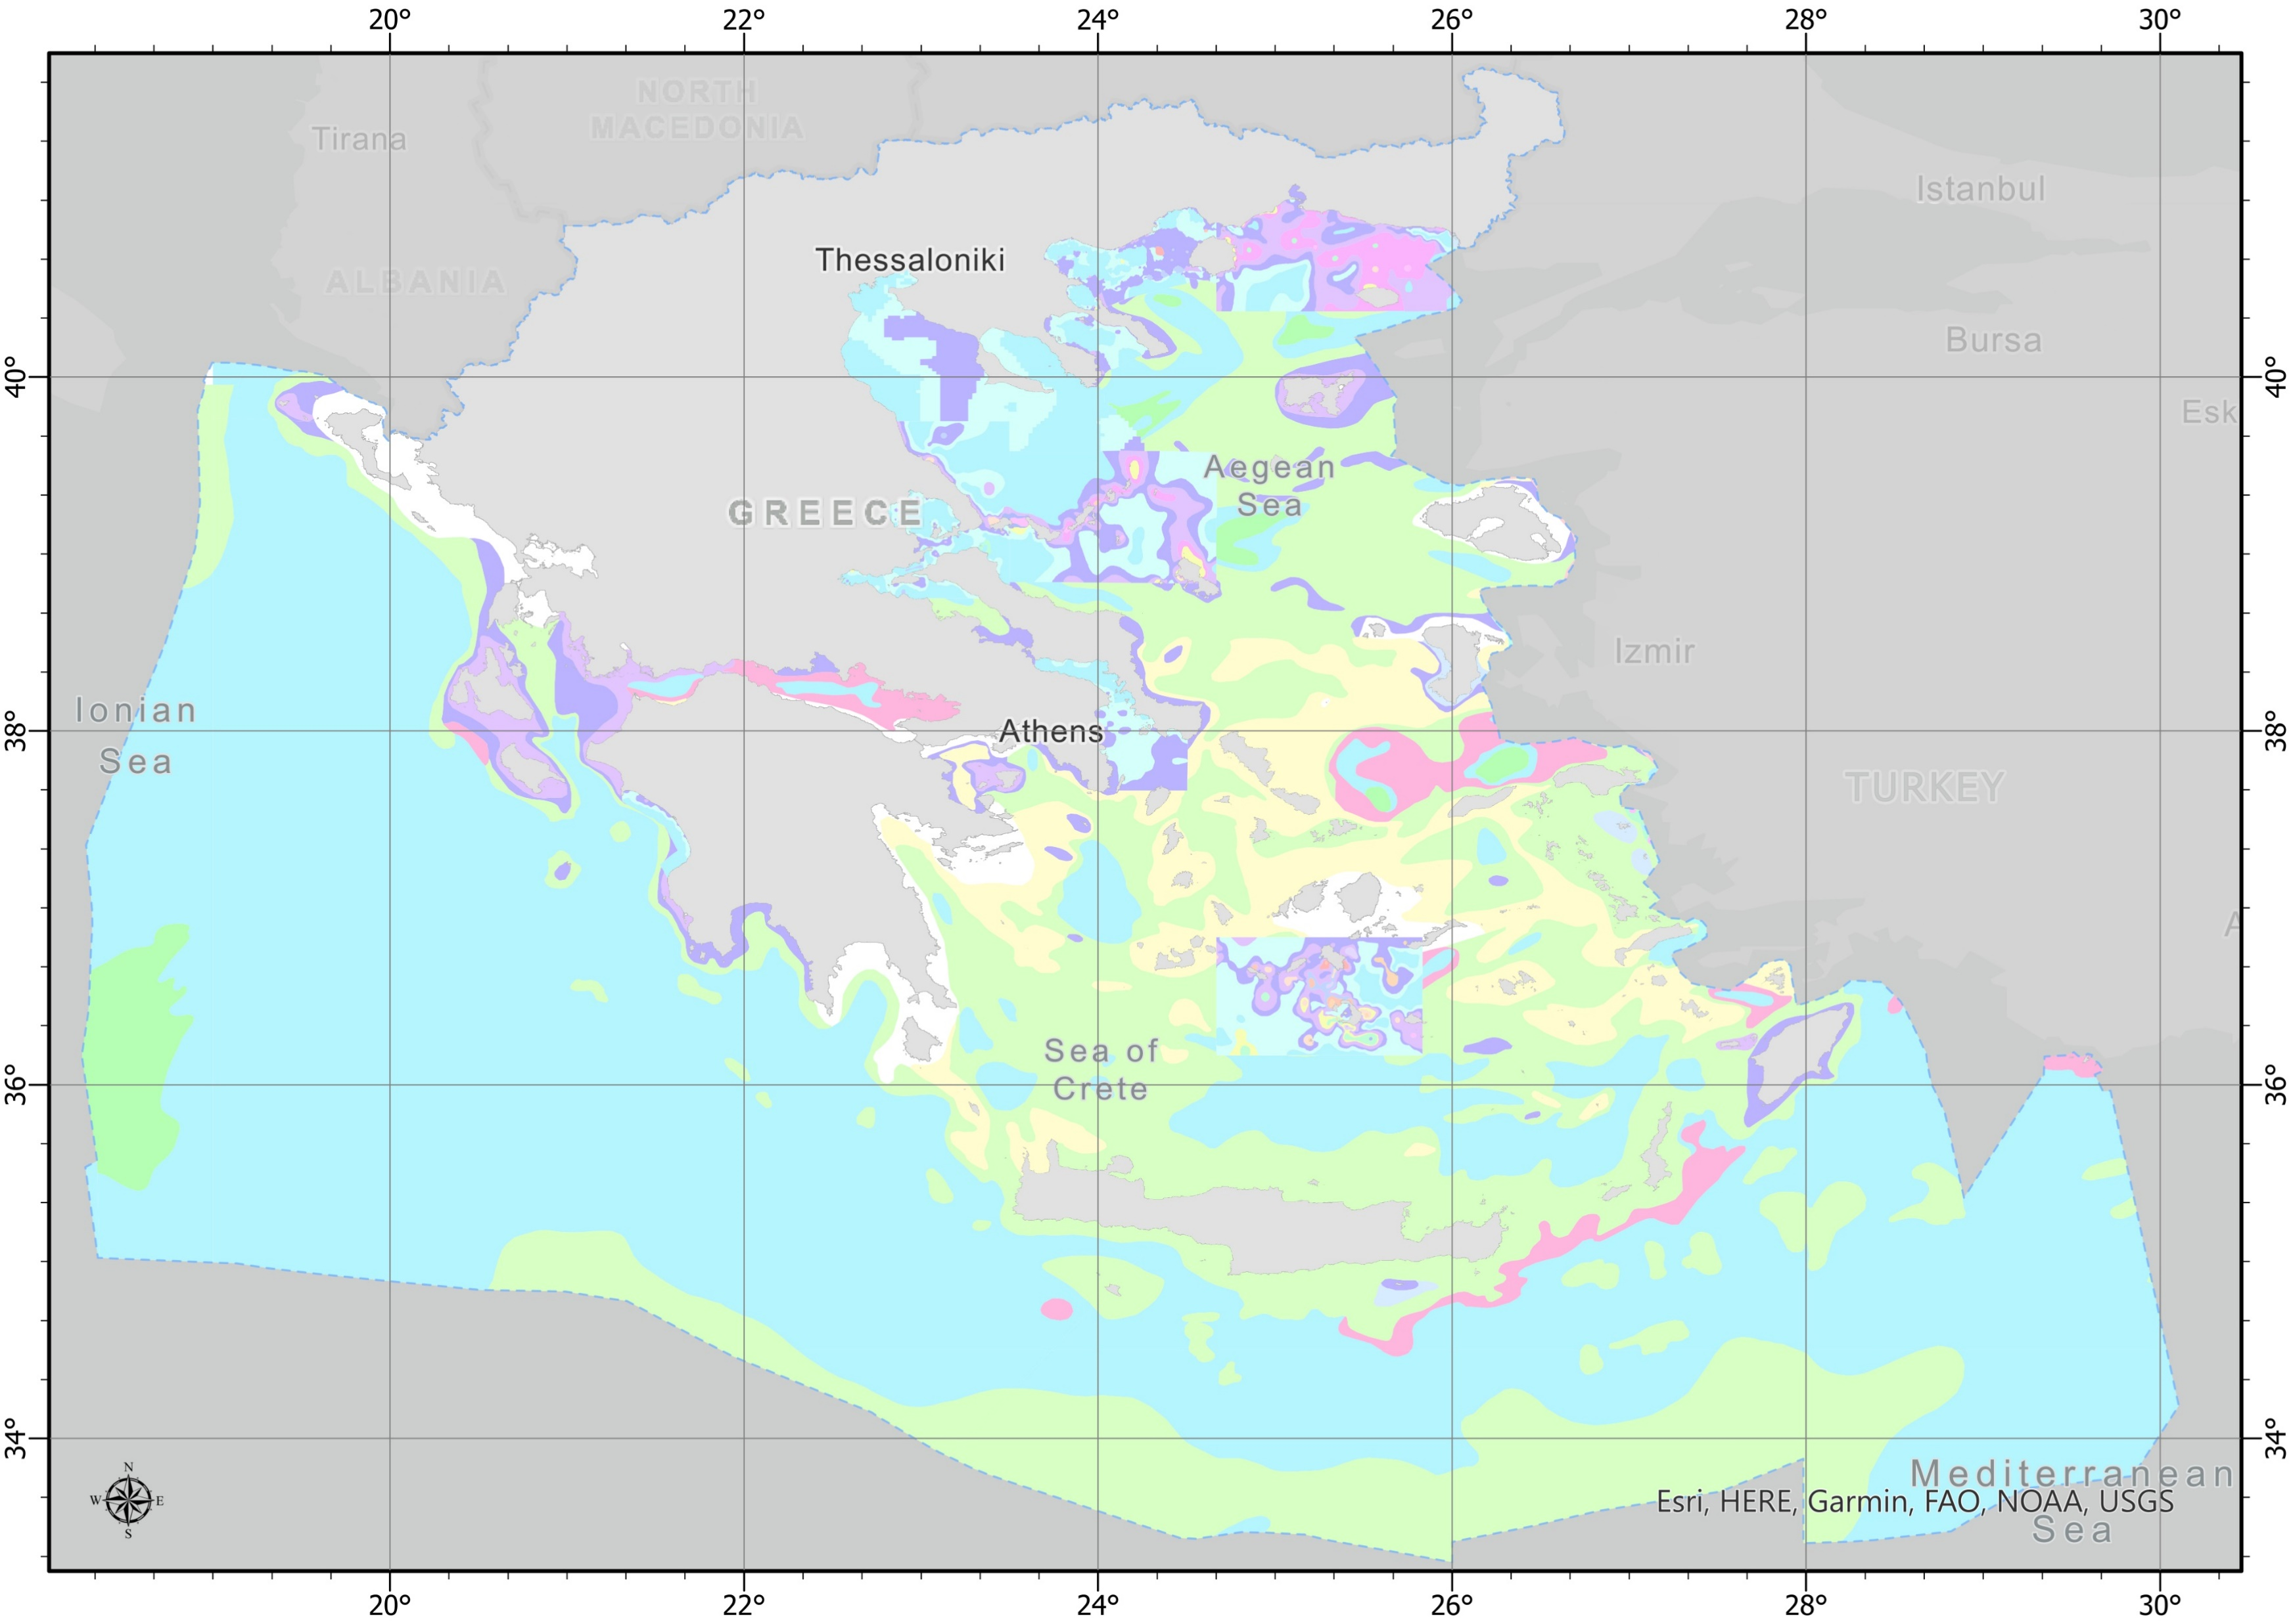
Suitability assessment of the Greek Maritime Area for the Development of Offshore Wind Farms
Site Identification – examples of applying data layers
Areas of Environmental Interest
Geological zones
12th December 2022
Slide 19

Slide 20
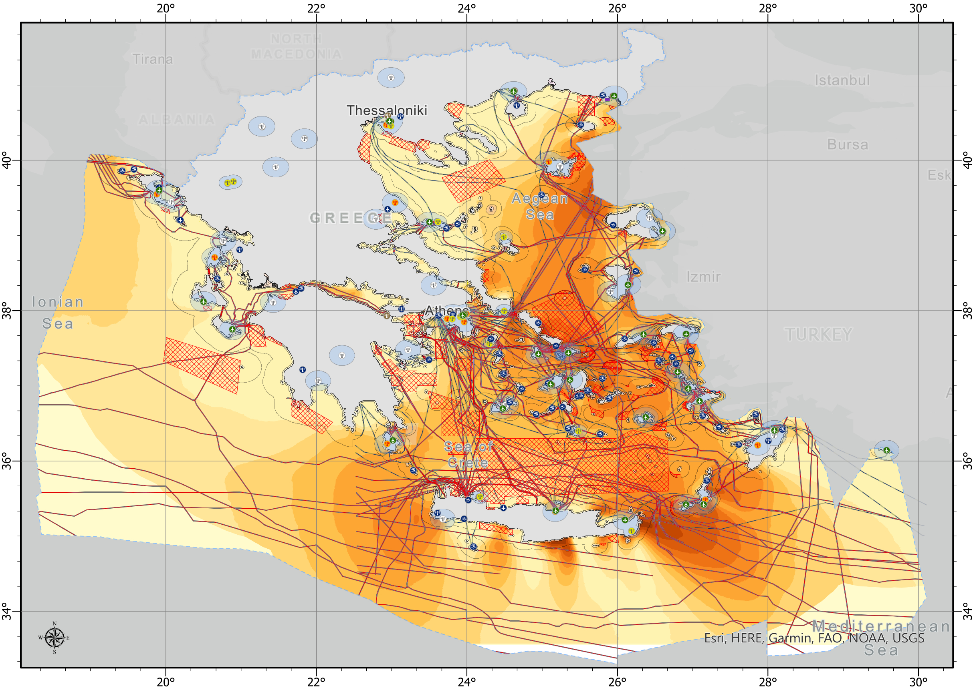
Suitability assessment of the Greek Maritime Area for the Development of Offshore Wind Farms
Site Identification – examples of applying data layers
Wind speed zones
Aviation facilities and protection zones
Military Areas/National Security Areas
Navigation lines and protection zones
Electricity/Telecommunication/
Natural Gas pipelines and protection zones
Ship wrecks and protection zones
Hydrocarbon areas
Antiquity areas and protection zones
12th December 2022
Slide 20

Slide 21
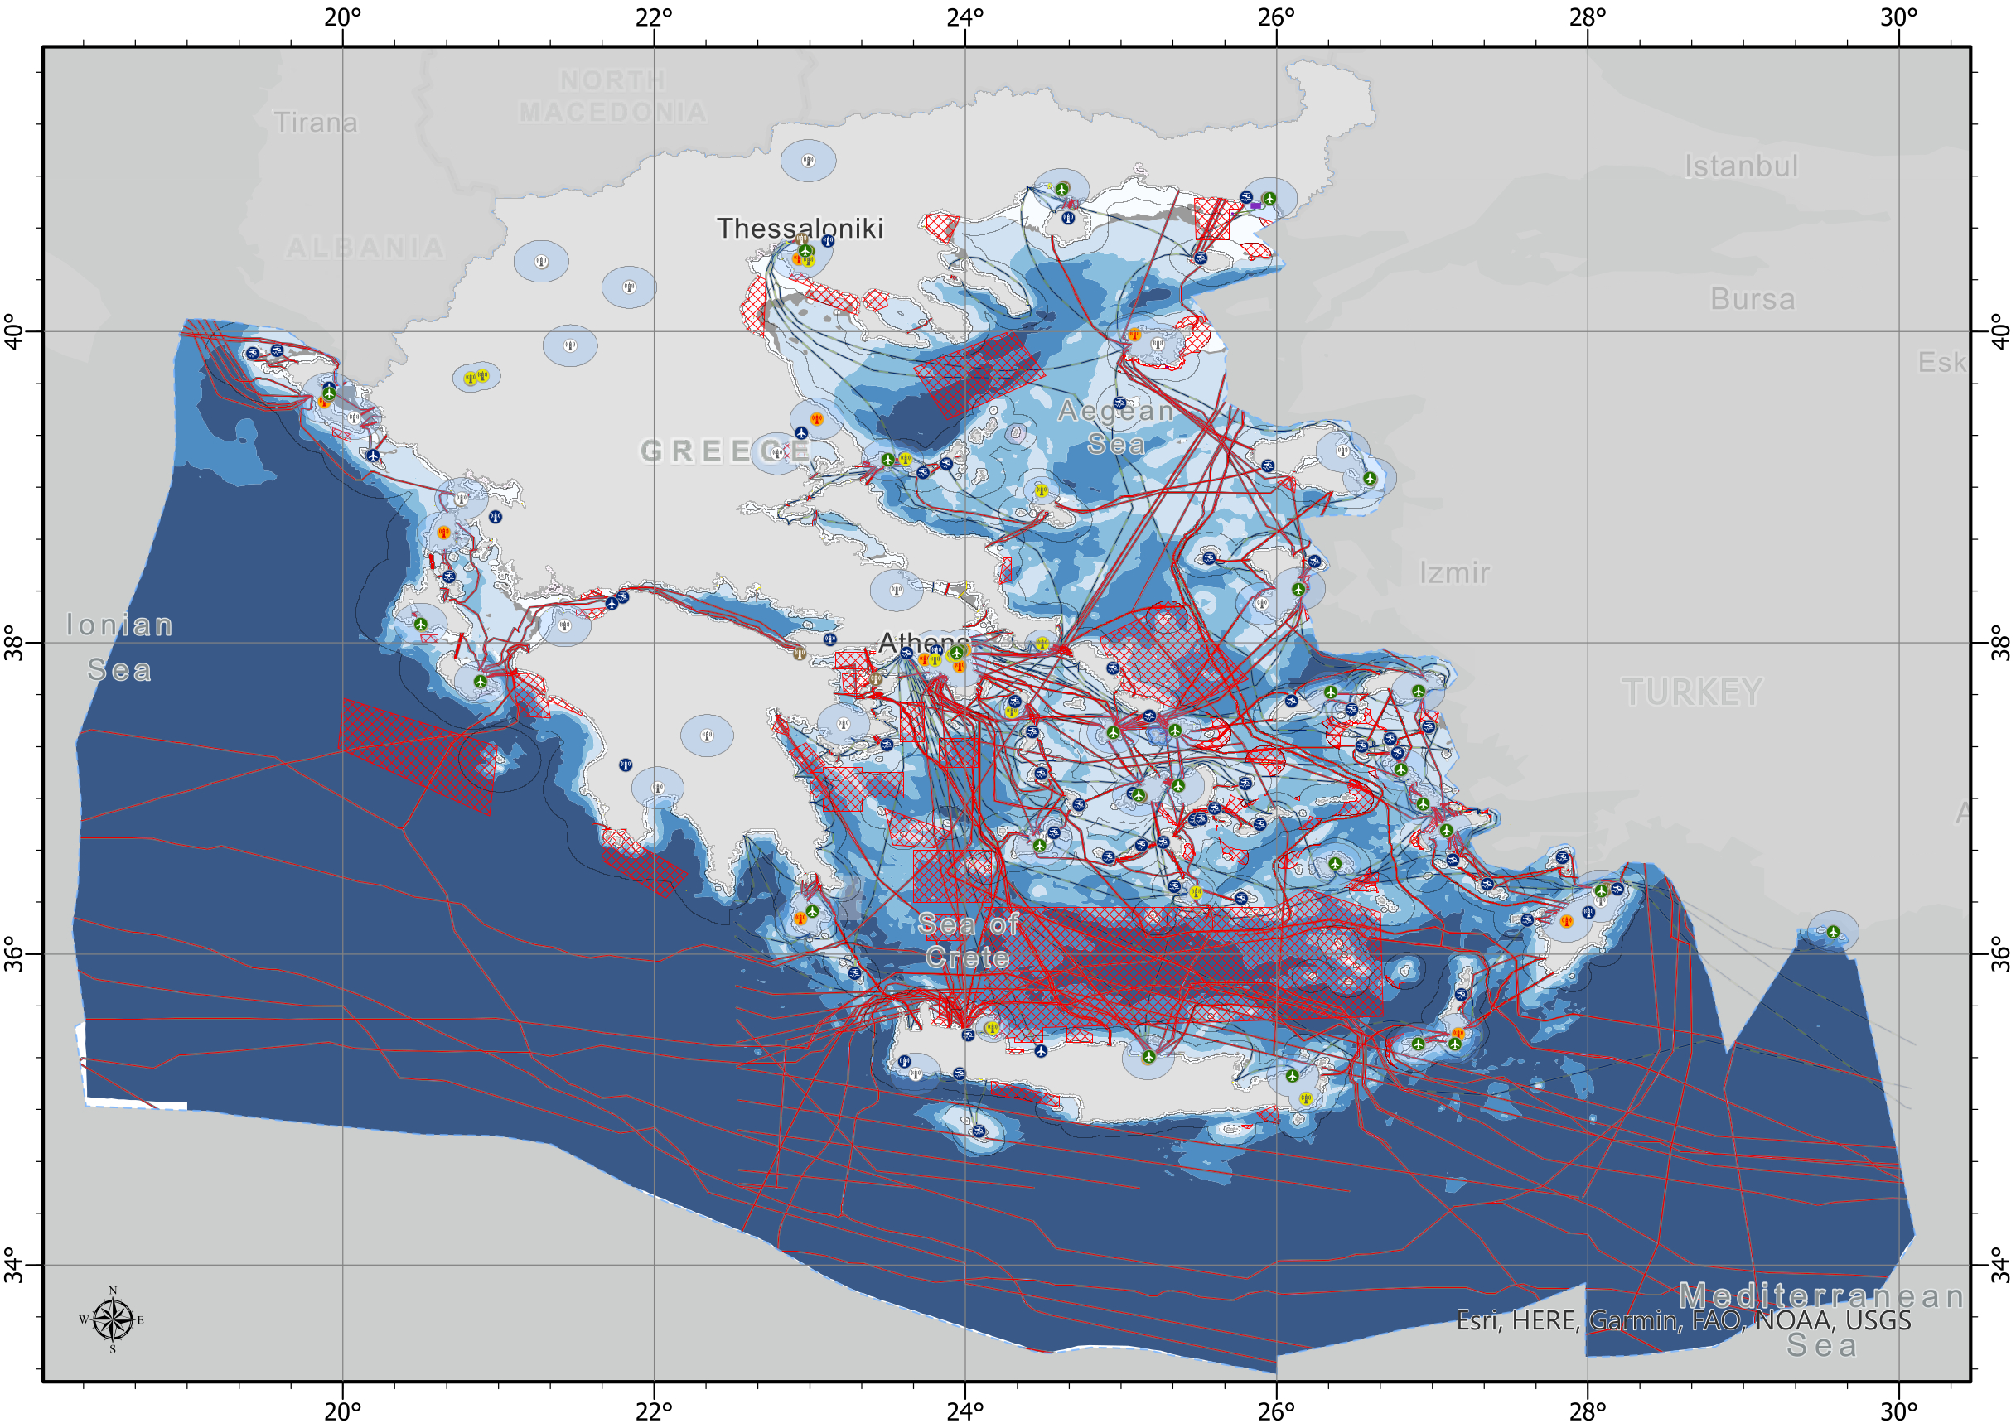
Suitability assessment of the Greek Maritime Area for the Development of Offshore Wind Farms
Site Identification – examples of applying data layers
Bathymetry zones
Aviation facilities and protection zones
Military Areas/National Security Areas
Navigation lines and protection zones
Electricity/Telecommunication/
Natural Gas pipelines and protection zones
Ship wrecks and protection zones
Hydrocarbon areas
Antiquity areas and protection zones
12th December 2022
Slide 21

Slide 22
Suitability assessment of the Greek Maritime Area for the Development of Offshore Wind Farms
Illustration of an indicative
receptive area
suitable for OW development
12th December 2022
Slide 22

Slide 23
Suitability assessment of the Greek Maritime Area for the Development of Offshore Wind Farms
Areas receptive to offshore Wind technology
38% Unavailable area due to On/Off criteria (km²)
26% EEZ area inside NM (km²)
74% EEZ area outside NM (km²)
62% Available area inside NM (km²)
The total area of ​​the Greek Exclusive Economic Zone (EEZ) is approximately 482,000 km². The available area of ​​national maritime space within Nautical Miles amounts to 26%
Based on the application of the exclusion criteria, it appears that the total area available for exploitation is of the order of 62% of the area within the NM
12th December 2022
Slide 23

Slide 24
Suitability assessment of the Greek Maritime Area for the Development of Offshore Wind Farms
Areas receptive to offshore Wind technology
0.15% Available area inside EEZ for fixed OW projects (km²)
0.15% in the Greek EEZ is potentially available for the development of fixed bottom OW projects, including the techno-economic limitations set. This is an area of approximately 750 km² of the total 482,000 km² of the EEZ.
Based on initial estimations a capacity of 4 to 7 GW of fixed bottom OW projects can be hosted within the above-mentioned area.
99.85% Unavailable area inside EEZ (km²)
12th December 2022
Slide 24

Slide 25
Suitability assessment of the Greek Maritime Area for the Development of Offshore Wind Farms
Areas receptive to offshore Wind technology
1.6% Available area inside EEZ for floating OW projects (km²)
1,6 % in the Greek EEZ is potentially available for the development of floating OW projects, including the techno-economic limitations set. This is an area of approximately 7.700 km² of the total 482,000 km² of the EEZ.
Based on initial estimations a capacity of 35 to 70 GW of floating OW projects can be hosted within the above-mentioned area.
98.4% Unavailable area inside EEZ (km²)
12th December 2022
Slide 25

Slide 26
Suitability assessment of the Greek Maritime Area for the Development of Offshore Wind Farms
Next Steps
Strategic Technical report identifying suitable areas for OWF development
National Offshore Wind Development Plan
Strategic EIA (SEIA)
Report including the site identification methodology, selection criteria, and identified areas
SEIA at a national level for the impacts on natural and human environment
National Offshore Wind Development Plan that is approved via a joint ministerial decision from the relevant ministries
12th December 2022
Slide 26

Slide 27
Suitability assessment of the Greek Maritime Area for the Development of Offshore Wind Farms
Next Steps - Opportunities
Jobs
Benefit local communities through creation of FTE jobs during the lifecycle of the wind farm
Opportunities
Tech Hub
Become a technology hub exporting products to other markets in Mediterranean
Brain gain
Repatriate highly qualified personnel.
Offices
Offices
Resources
Supply Chain
Integrate local supply chain in the offshore wind projects – obvious benefits for fabrication yards and shipyards
Energy Hub
Combine Offshore Wind with green alternative fuels and create national and international energy hubs
Industry crosspollination
Leverage on Greek maritime industry experience on OW supply chain
12th December 2022
Slide 27

Slide 28
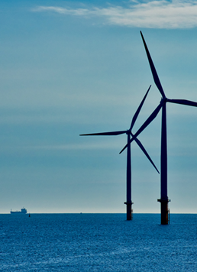
Suitability assessment of the Greek Maritime Area for the Development of Offshore Wind Farms
Next Steps - Opportunities
In Conclusion
Greece has made stable first steps towards the incorporation of the OW technology in its energy mix.
Greece has the potential to become an attractive market and competitive to the other countries regarding OW, and has the ability to complete and finalize the procedure with quick steps in order not to lose the momentum.
The Greek Offshore Wind Act has several advantages: the initial assessment of the areas, the fact that the grid connection in a significant part will be under IPTO and will be secured, the synergies created with the ministries and authorities.
Greece has the ability also to focus to the preparation, support and improvement of related infrastructures, such as ports and shipyards.
The involvement and cooperation with all related stakeholders will continue and involve even more interested parties.
Project Development
12th December 2022
Slide 28

Slide 29
GET IN TOUCH
W: www.developmentfariagroup.com
E: contact@developmentfariagroup.com
53, Vasileos Irakleiou str. & Karolou Ntil str.
EL-54623 Thessaloniki
Greece
Memberships:

