Slide 1
Competitive advantages and added value to the Greek economy by the development of an Offshore Wind Industry
Offshore Wind Energy in Greece: The way forward
12/12/2022
Nikos Frydas
Principal, Energy Sector, Vice President of Grant Thornton Tax and Business Advisory Solutions

Slide 2
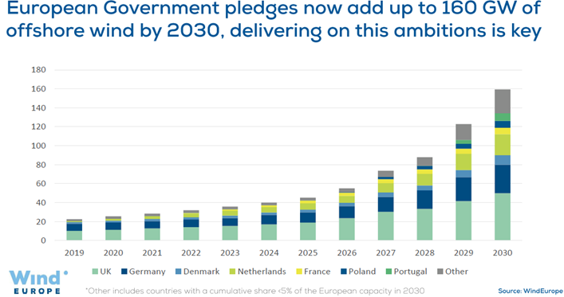
Offshore Wind an indispensable component of EU’s energy mix
Offshore Wind
in EU’s “Green Deal”
2030: Reduction of Greenhouse Gas (GHG) emissions by at least 55% compared to 1990 & 60 GW of Offshore Wind Capacity
2050: Net zero GHG emissions & 300 GW of Offshore Wind Capacity
Buy side & Sell side valuations for:
M&A transactions
Intangible assets (brand names, patents, licenses etc)
Single exposures, loan portfolios & other financial assets
Collaterals
Greek Offshore Wind targets
2030-2031 Greek targets: 2 GW of Offshore Wind
7 TWh of generated energy
2,8 Mton of CO₂ avoided
1,1 bcm of NG displacement
2050 Greek targets: Up to 20 GW of Offshore Wind
Rollout of 2-2,5 GW every 3 years (2030-2050)
Added Value
(construction & operation)
Steel industry
Cable industry
Construction companies
Ports (main & local)
Shipyards

Slide 3
Competitive advantages and added value to the Greek economy
Significant Expected Investments* > 6 billion € by 2030 and > 28 billion € by 2050 - Attracting foreign investments with high Greek added value (67% expected to be part of the Greek economy and from the rest significant part in the EU)
According to our estimations, more than 8.000 permanent and highly specialized new jobs will be created
Increase of the exporting manufacturing capabilities (cables, foundation, equipment) and creation of new ones
Shipyards can manufacture or repair transport vessels (crew transfer, service operations) and specialised installation vessels (component transport, foundation installation, cable installation etc.)
Training and Research institutions
*Investments take into consideration the entire Wind Farm Lifetime (25 years) and all the relevant costs (CAPEX + OPEX) | Estimates in 2025 prices | Discount Factor: 5,2%
Floating Wind Parks add higher percentage value to the Greek economy compared Fixed
Jobs in relevant Industries
Exploitation Potential
Semisubmersible Platforms, Towers, cables
Greek sea basin
Significant Synergies
Hydrogen (Parallel Production)
Oil and Gas Industry
Greece (Greek Hydrogen Hub)
Personnel skills

Slide 4
Value to the Greek Manufacturing sector
Substations
Offshore and Onshore facilities
(Structure and auxiliary equipment)
Wind Turbine
Tower
Nacelle Parts (Bedplate, shaft, auxiliary systems, components)
Rotor Parts (Steel components)
Cables
Intra Array Cables
Export Cables
Monopile
Jacket
Transition Piece
fixed Foundations
Floating offshore wind parks
Semisubmersible Platform
Support Vessels
Note: Significant part of the manufacturing will take place within ports that encompass several uses (Manufacturing, Construction, Staging, Operations & Maintenance)

Slide 5
OFW stages and equivalent new job creation
c. 8000 permanent Jobs*: sectors where they will be created
Operators
Electrical and naval engineers
Construction workers
Crane operators
Ship crew
Technical personnel
Management
Construction workers
Technical personnel
Naval engineers
Ship Crew
Health and safety
Logistics and quality
Project Manager
Operators
Factory workers
Quality control
Marketing and sales
Engineers
Management
Administration
Project planning and development
Transport
Grid connection
Decommission
Engineers
Environmental and geotechnical scientists
Financial Analysts
Legal Counsel
Insurance Specialist
Ship crew
Drivers
Ship Crew
Technical personnel
Construction workers
Technical personnel
Engineers
Health and safety experts
Construction workers
Technical personnel
Drivers
Engineers
Ship Crew
Environmental scientists
Health and safety experts
Manufacturing
Installation
Operations
& Maintenance
*Jobs refer to Full Time Equivalent (FTE) permanent jobs until 2050 assuming 2GW until 2030 and 2-2,5 GW (mostly Floating Parks) every 3 years afterwards
It is noted that the Jobs in the Ports are included in the relevant stages
Source: (IRENA 2018, BVGA 2019, NREL 2022, GT)

Slide 6
Thank you!

