Slide 1
CRES’ institutional role, experience and current activities
2nd Session: Policies and Financing
Offshore Wind Energy in Greece
Institutional framework, challenges and perspectives
Tuesday, 23 February 2021

Slide 2
CRES’ Institutional role
Enable Greece meet its NECP goals.
Energy Policy Advisor
R&D Centre
CRES has been established in 1987 by the Ministry of Energy and the Environment as the Hellenic Institute with mission, to maximize the implementation of
Renewable Energy Sources (RES),
Rational Use of Energy (RUE), and
Energy Efficiency (EnEff) policies.
CRES operates currently, within its institutional framework, both as:
An Energy Policy Advisor to the Ministry of Energy and the Environment and;
An R&D Centre, for innovative technologies and policies in the fields of RES, RUE and EE,
with final aim to enable Greece meet its National Energy and Climate Plan (NECP) goals.

Slide 3



HWEA Project: Necessary legislative adjustments to promote offshore wind energy in Greece
CRES, within the framework of the above project, carried out a review of the institutional frameworks in countries with mature Offshore Wind Farms (OWF) markets.
CRES gathered, analysed and presented the practices of above countries, focusing on:
critical issues affecting the speed of project development,
the investment climate, and
the cost of projects.
Aim: understand alternative approaches and solutions in Europe and consider best practices to develop the most sustainable institutional framework for OWFs in Greece.

Slide 4
Different models for the development of OWFs
Centralized model: The State selects the zones, areas, and the time of implementation of OWFs, based on determined RES and Maritime Spatial Planning. Then grants them to corporations after the successful completion of a competitive process.
The interconnection of OWF with the Electricity Transmission System is the sole responsibility of the Transmission System Operator for both the marine and land sections.
Decentralized model: The State’s participation goes as far as identifying the extensive areas where OWF can be implemented. The specific planning within these zones, as well as the development of the projects, are carried out under the responsibility of private investors who acquire the right to study and propose, within the designated areas, their projects. In the countries where the decentralized development model is applied, the interconnection works of OWFs, maritime and land, is under the responsibility (technical and financial) of private investors.
Intermediary model: The development of OWFs is combing elements from both models. Regarding the interconnection of OWF under this model usually the responsibility is shared between the investors for the marine part of infrastructure and the TSO for the land part.
Regardless who is responsible for the specification of projects (state or developers)
IN ALL MODELS
the prerequisite for the launching of a competition procedure, is the spatial designation of zones in the sea, where the planned OWFs will be installed.

Slide 5

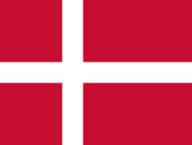




Different models for OWF development
Centralized Model
Intermediary Model
Decentralized Model
the State: selects the zones and the sites and the time of implementation based on its RES and Marine Spatial planning. prepares all the required environmental studies, including studies on OWF interconnection grants the sites to individuals based on the results of a tender process where the bidder with the lowest price per kWh is selected.
Combination
The State identifies extended zones Developers implement zone and site planning, as well as the project development: get the rights to study and propose, within the defined large zones, their projects (all measurements, studies etc. are done by them) providing they can demonstrate that they, or their partners, have the necessary financial strength and technical competence to deliver have the opportunity to bid for any projects. The final decision on project allocation, is based on the option fee value, proposed by the Bidders.
Belgium: 100% centralized model
Denmark and the Netherlands adopt models closer to the centralized one with the public authority undertaking the entire development phase, which includes the selection of the installation site, the design of the OWF and the interconnection, their study and licensing as well as and the granting of the connection right and the right to use the area. All permits are secured by the state, public authorities pay and build the connection network, public authorities handle important investment issues such as development, the connection
Germany the Federal Maritime and Hydrographic Authority is responsible for the development and initial examination of offshore areas for the construction and operation of the OWFs. The determination of OWF positions is done through the "Position Development Plan" which is prepared by the Organization, where exactly the positions.
The Federal Maritime and Hydrographic Agency then conducts a pre-examination of the sites in order to determine their suitability and to provide interested parties with all the information required for the bidding procedures during the bidding process.
France applies an intermediate model with more proportions to the "decentralized" model. The procedure followed first involves the selection of wider marine areas suitable for OWF by the authorities and then, through a screening process involving a discussion with the industry and the local community, the determination of the final location for which compensation is being tendered
U.K 100% decentralized model

Slide 6


OWF grid connection costs / responsibilities
TRANSMISSION NETWORK
OWF
OFFSHORE AC SUBSTATION
LAND SUBS STATION
Belgium | TSO | TSO | TSO
Denmark | Developer (subject of the tender) | Developer (subject of the Tender) | Responsibility of the TSO Cost paid by the Developer
France | TSO | TSO | TSO
Germany | TSO | TSO | TSO
Netherlands | Responsibility of the TSO Developers are charged a certain amount to the TSO which varies depending to connect to the land network |  | TSO
United Kingdom | Developer | Developer | Responsibility of the TSO Cost paid by Developer
Submarine Cable
Offshore Substation
Onshore cable
Land substations

Slide 7
Maritime Spatial Planning – The missing link
Law 4546/2018: “Establishment of a framework for the national maritime spatial planning in implementation of Directive 2014/89 / EU”
  Scope:
  Supporting and promoting sustainable development and the spatial cohesion between the marine and the coastal space, through the composition of ecological, environmental, economic, social and cultural parameters, considering the land-sea interactions, ecosystem approach and, more generally, the principles of sustainable management.
  Rational and integrated spatial development of activities in the maritime and coastal areas.
  i.e.
The National Maritime Spatial Planning must allocate space in the Greek seas and coastal areas for all possible needs, uses and non-uses, considering, among other, the following:
  Biodiversity protection
  Energy production
  Fishing & aquaculture
  Resource exploitation
  Tourism & cultural inheritance
  Marine traffic
  Defense

Slide 8
Maritime Spatial Planning
Offshore wind in the Greek seas: the first attempt
  “Strategic environmental Assessment of the National Program for the development of marine wind farms”
  Project assigned by the Ministry of Energy and Environment to a consortium consisted of CRES (coordinator), HCMR (Hellenic Center for Marine Research) and ENVECO (consulting company)and funded by EU-ERDF/ΕΣΠΑ 2007-2013 /MIS 375406). Completed in 2015.
  Preliminary assessment of offshore wind potential in the Greek seas, and investigation of possible areas for offshore wind development.
  Screening for technical and environmental restrictions and conflict of uses (tourism, fishing, military, etc.)
  Only BOTTOM FIXED foundations examined.

Slide 9
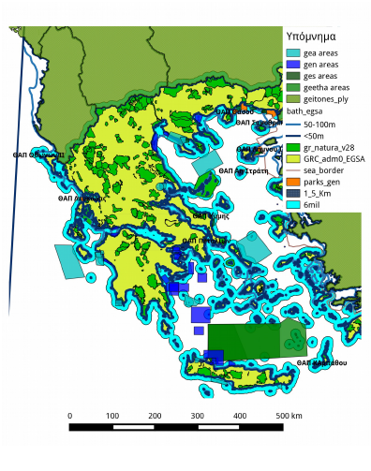
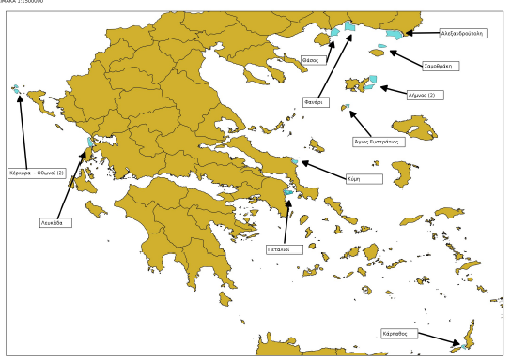
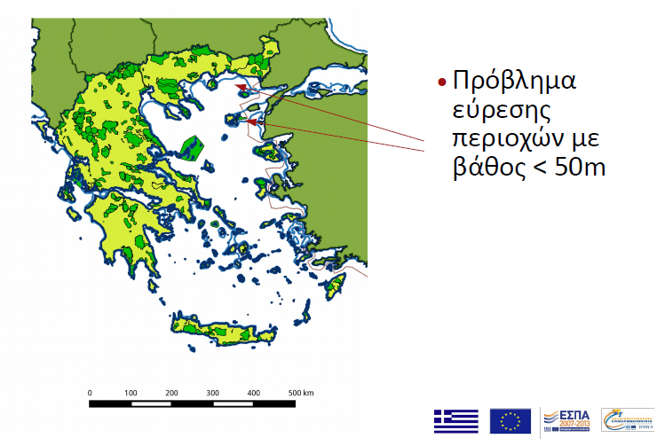
Maritime Spatial Planning
Offshore wind in the Greek seas: the first attempt
Identify potential OWF sites
depth < 50m
Distance from shore
1.5 km - 11 km (6nm)
Exclude nature protected areas
Exclude other uses (mainly military training areas).
First estimation result (2015):
1500- 3500 MW of bottom fixed offshore wind could be feasible deployed in the Greek seas
Field status today (RAE data):
8 projects (bottom fixed) with a combined installed capacity of 2700MW at planning and permitting phase.

Slide 10
Maritime Spatial Planning
Offshore wind in the Greek seas: the next step
Update technology based criteria
  (e.g., floating offshore support structures which could be deployed at sea bottom depths up to 400m)
Interaction with transmission grid planning
  (connection of islands to mainland grid, international interconnections, special hubs for offshore wind/blue energy connections)
Investigate multiple use of marine platforms
  (combined RES production, aquaculture, biodiversity monitoring, maritime surveillance)
Interaction with National maritime Spatial Planning
  (reconsider all restrictions)
Short term target:
identify larger maritime areas suitable for offshore wind (including floating)
Running exercise (in progress)
Mapping offshore RES potential around Crete - including floating OFWs
(project BLUE DEAL – Interreg Med)

Slide 11
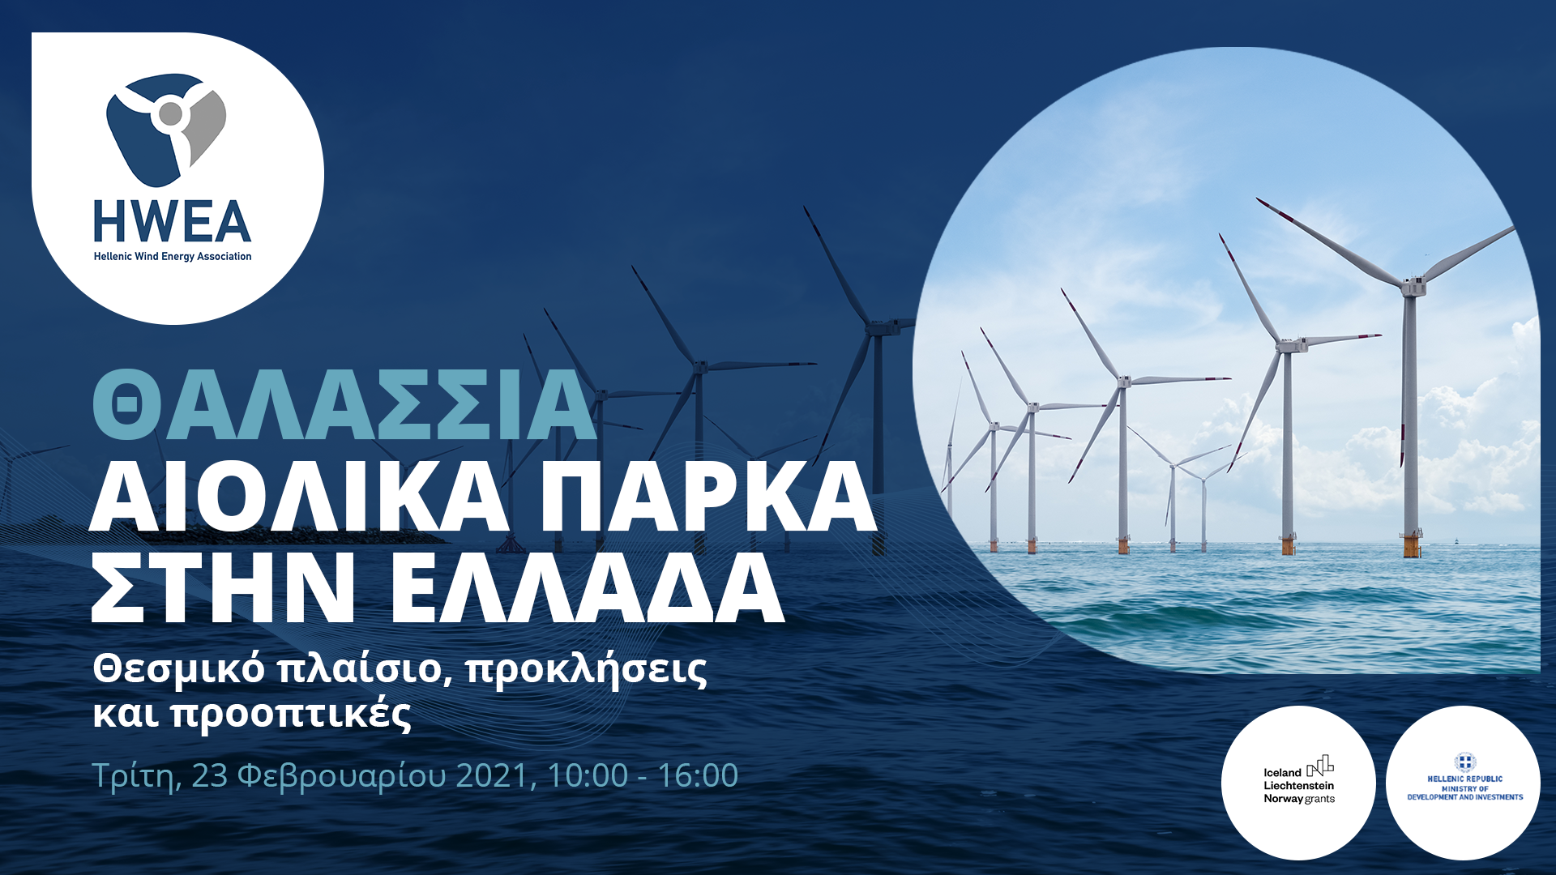
Thank you for your attention
19th km. Marathonos Ave., 19009, Pikermi Attica Greece
Τel.: +30 210 66033222, grpr@cres.gr
www.cres.gr

