Slide 1
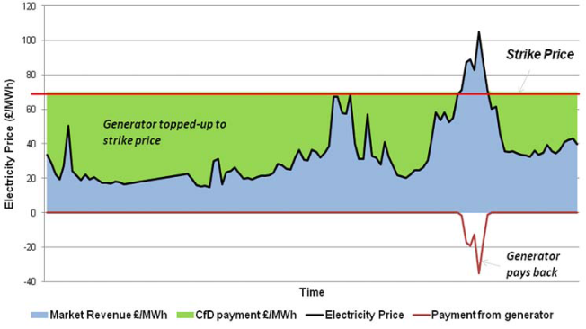
From Feed-in Tariffs to tenders:
The transition to a new era in Greece
Panagiotis G. Papastamatiou
Hellenic Wind Energy Association, HWEA/ELETAEN
23 November 2017
Workshop in Athens

Slide 2
Total RES-E generation in GWh, 2010-2016

Slide 3
The new support mechanism
A new RES support mechanism (Sliding Feed In Premium) is Approved by DG Comp (SA 44666) and is in force since November 2016
This mechanism is in line with the Guidelines on State aid for environmental protection and energy 2014-2020 (2014/C 200/01)
Approved
http://ec.europa.eu/competition/elojade/isef/case_details.cfm?proc_code=3_SA_44666
New Law 4414/2016 (New RES support mechanism) is in force since August 2016

Slide 4
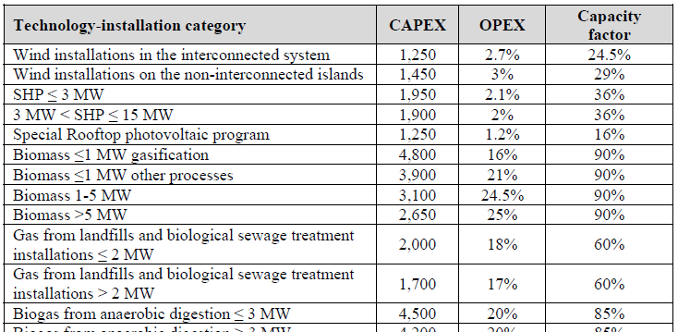
Cost assumptions for the new FiP for 2016

Slide 5
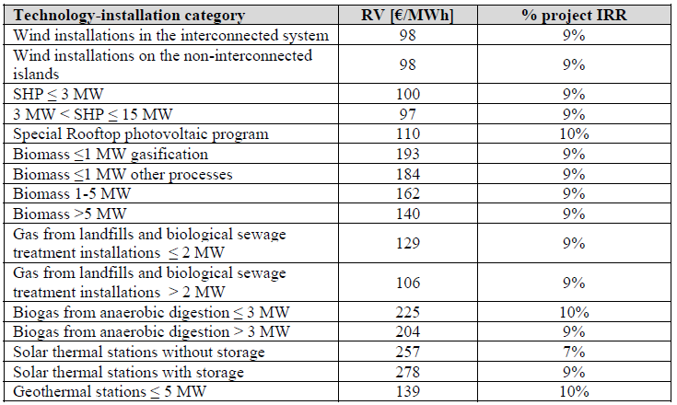
Premium and assumed IRR for 2016

Slide 6
Assumed marketing and forecasting costs

Slide 7
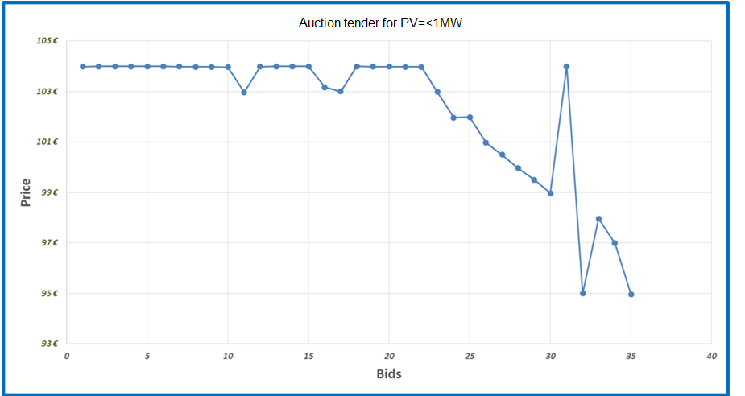
2016 Pilot auction for PV$≤$1MW

Slide 8
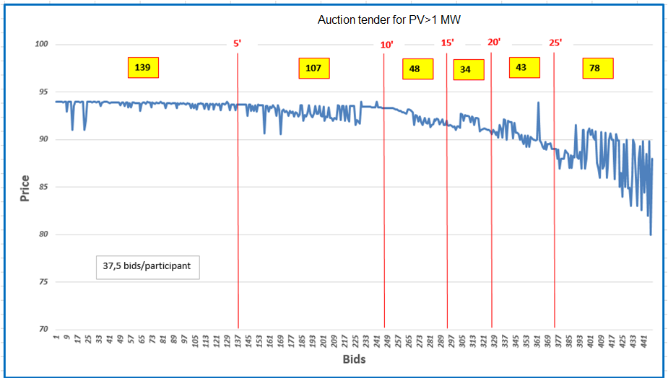
2016 Pilot auction for PV>1MW

Slide 9
HWEA Wind Energy Statistics – September 2017
Sept

Slide 10
HWEA Wind Energy Statistics – September 2017
New wind capacity connected, 2016:
234,35 MW (all FiT)
New wind capacity connected, 1-9/2017:
120,95 MW (all FiT apart from 2,35MW FiP)
Under construction or contracted:
approx. 170 MW with FiT
approx. 140 MW with FiP
plus approx. 65 MW
Sept

Slide 11
Towards 2020 and beyond
Assumed National Target*
National Target

Slide 12
Towards 2020 and beyond
Assumed National Target*
National Target
We need approx. 4GW of new RES

Slide 13
Proposed principles for the new tendering system I
Technology specific tenders
grid stability and lower cost for grid operation
technology diversification
geographical diversification
Before the tenders
Adequate capacities
maintain market growth
2030 targets
Specific and predefined program for tenders up to the end of 2020
visibility and appropriate policy messages to the market
boost of projects development
Often and electronic tenders
Predefined general terms applied to all tenders
visibility
investments security

Slide 14
Proposed principles for the new tendering system II
The required RV is the only criterion for the tender
transparency
efficiency
As long as competition exist, there is no need for upper limit for the bids
Within the tenders
Flexibility for the capacity which may be applied in a tender by a project
at least –but not necessarily equal to- the licensed capacity
Mature projects eligible for the tenders
Adequate participation guarantees
avoid speculation
secure price feasibility

Slide 15
Proposed principles for the new tendering system III
Security needed for the selected projects
objections, which may be accepted in the future, should not have any impact on them
Proper good-performance-guarantee
After the tenders
Adequate time-frame for project completion
special care for force majeure and juridical orders for halt of works
Adaptation of licenses’ duration
the duration is freezed and starts from the completion of the first tender where the project is eligible for participation
Licenses modifications are permitted after project selection
subject to not increasing the capacity beyond 10%
A selected project cannot participate to future tenders

Slide 16
Thank you for your attention
23 November 2017
Workshop in Athens

